Slide 1


https://videos.learning.redhat.com/media/Java+25th+Anniversary-+SKO2021+-+Sizzle+Reel+/1_m9p1173j
https://videos.learning.redhat.com/media/Quarkus+Overview+-+SKO2021+-+Sizzle+Reel+/1_k9eccopp

Slide 2
Kubernetes Native Java for Spring Developer
Kubernetes Native Application Series
Voravit Lertgitipongpant
Senior Solution Architect
Red Hat, Thailand
Chatchai Kongmanee
Specialist Solution Architect
Red Hat, Thailand

Slide 3

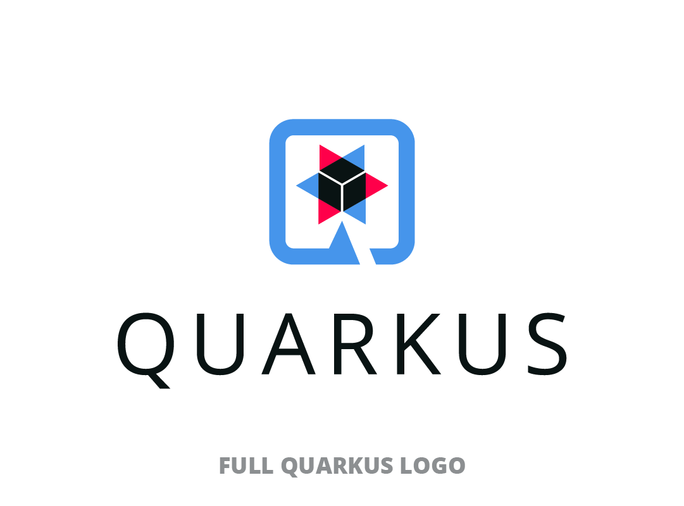

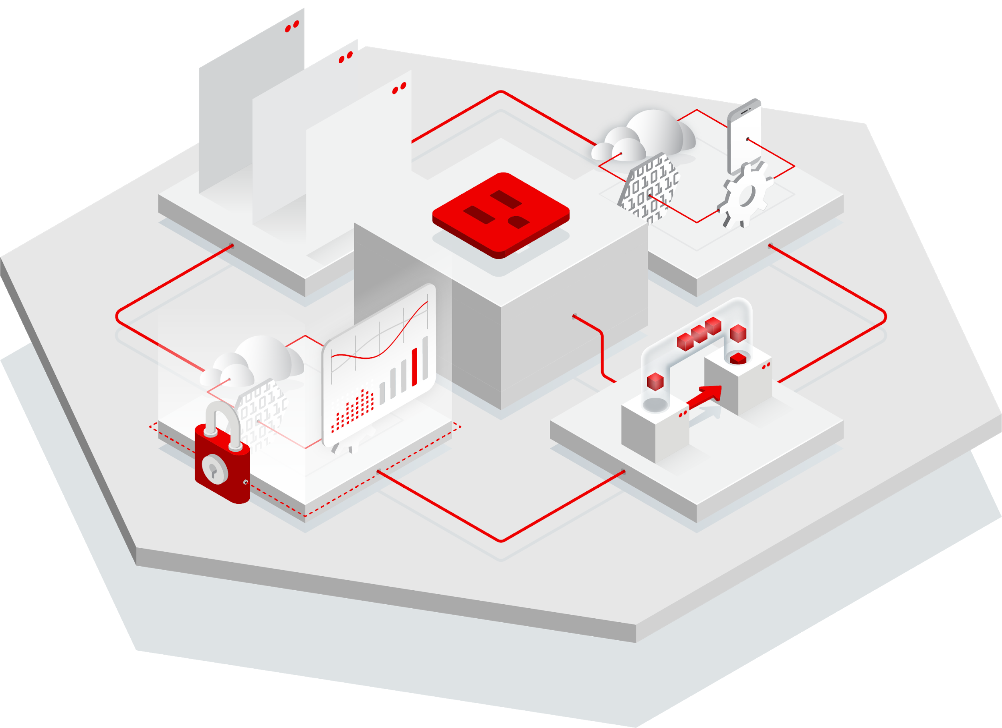

Date & Time
Date & Time
Kubernetes Native Java for Spring Developer
Transform same old spring boot application into Kube-Native Application with amazing fast boot time, small memory footprint and also focus on developer joy with Quarkus
Best Practices for Developing Kube- Native Application
Kubernetes Native Java for Spring Developer
Date & Time
Date & Time
Enhance your microservice on Kubernetes with Event Driven Architecture
Secure Kubernetes Native Application by OpenID with Keycloak

Slide 4
Agenda
Historical Enterprise Java Stack
Why Quarkus?
Demo: First Quarkus!
I’m a Spring developer. Why Quarkus?
Demo: Spring Boot on Quarkus: Magic or madness?

Slide 5
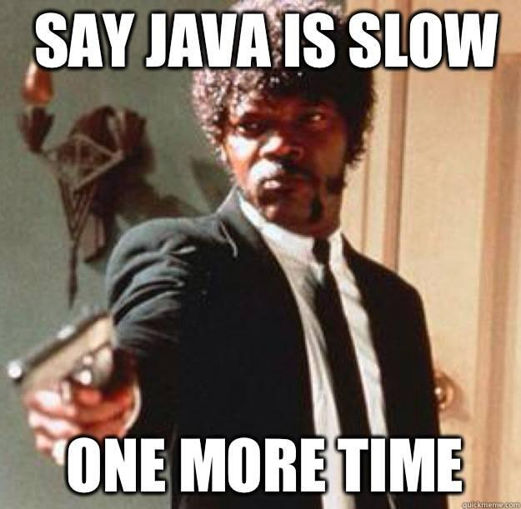
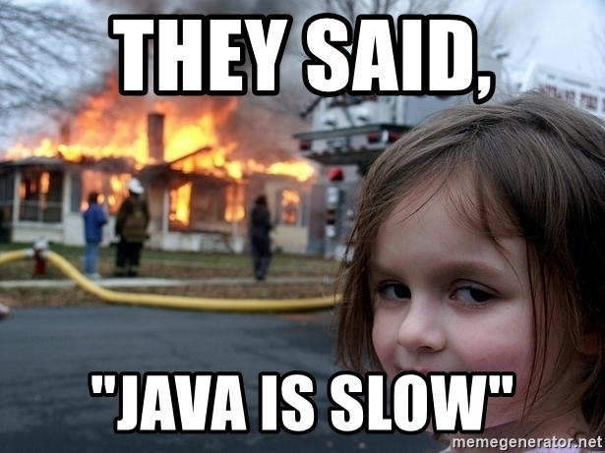

Slide 6
Historical Enterprise Java Stack

Slide 7

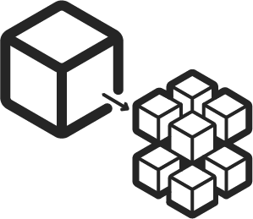










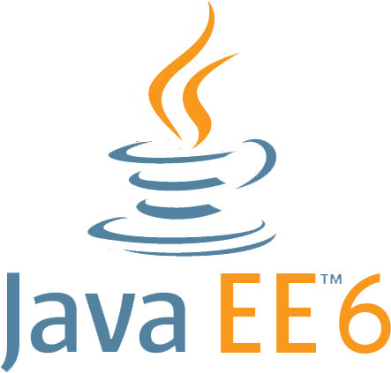



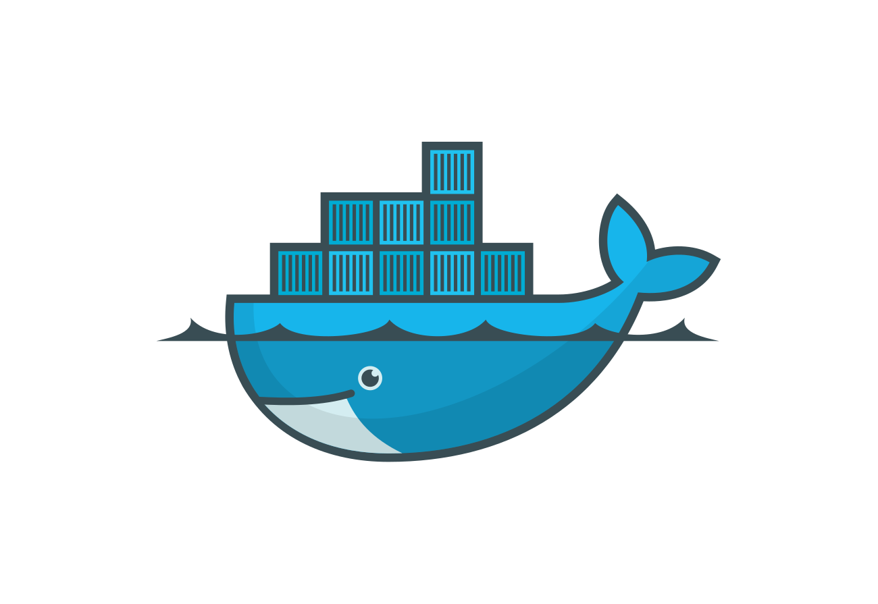




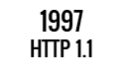








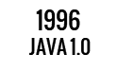






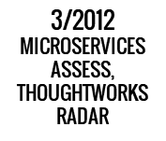



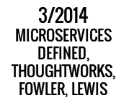



QUARKUS WORKSHOP
2000
RED HAT LINUX
2009
DEVOPS
2007
KVM
Notes:
Historical Java stack consisted of an application server running multiple applications. Red Hat has customers running over 100 applications on one JBoss EAP instance. Over most of the last 15-20 years, the Java application stack has been optimized to run large heaps and highly dynamic frameworks that make decisions at runtime.

Slide 8
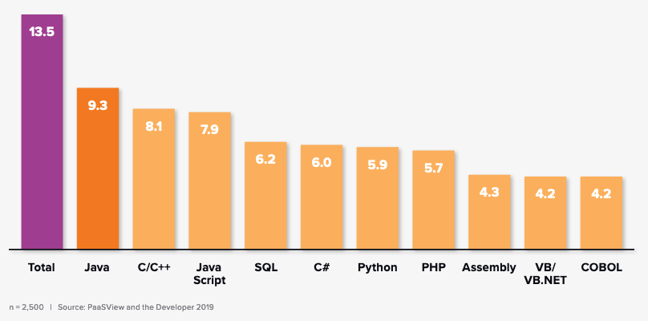
Is Java Still relevant?
Figure 1 below illustrates how more than two thirds of the world’s developers are “heavy to moderate” users of Java.
“As noted by IDC research, Java remains the most popular language used by developers worldwide: 9.3 million of the 13.5 million professional developers worldwide are “heavy to moderate” users of Java in comparison to 8.1 million for C/C++ and 7.9 million for JavaScript in 2020”
n=2,500 | Source: IDC PaasView and the Developer 2019

Slide 9
QUARKUS WORKSHOP
Cost of a Java-based Web App circa 1999
$18,000 Sun Sparc App Server Box (4 CPUs, 2GB of RAM)
+ $60,000 BEA Weblogic
+ $92,000 Sun Sparc DB Server Box (8 CPUs)
+ $243,000 Oracle RDBMS
+ $50,000 Symantec Visual Café for 10 developers
--------------------------------------------------
$463,000 (capex) + ~$80,000 annual maint (opex)
Notes:
Traditionally, customers built monolithic apps, so the whole stack was optimized for running many apps on an app server
As we move toward additional/different cloud native microservices/serverless/event-driven apps, devs want to take advantage of this operational model
Not yet mainstream for enterprises, but the need is there from our large-scale customers

Slide 10
Historical Enterprise Java Stack
QUARKUS WORKSHOP
Architecture: Monoliths Deployment: multi-app, appserver
App Lifecycle: Months
Memory: 1GB+ RAM
Startup Time: 10s of sec
App
App
App
App
App
Dynamic Application Frameworks
Application Server
Java Virtual Machine (Hotspot)
Operating System + Hardware/VM
Notes:
Historical Java stack consisted of an application server running multiple applications. Red Hat has customers running over 100 applications on one JBoss EAP instance. Over most of the last 15-20 years, the Java application stack has been optimized to run large heaps and highly dynamic frameworks that make decisions at runtime.

Slide 11
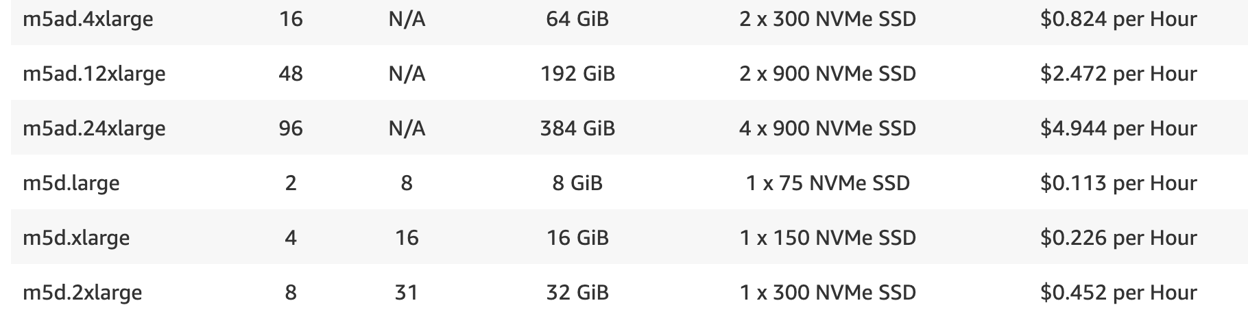

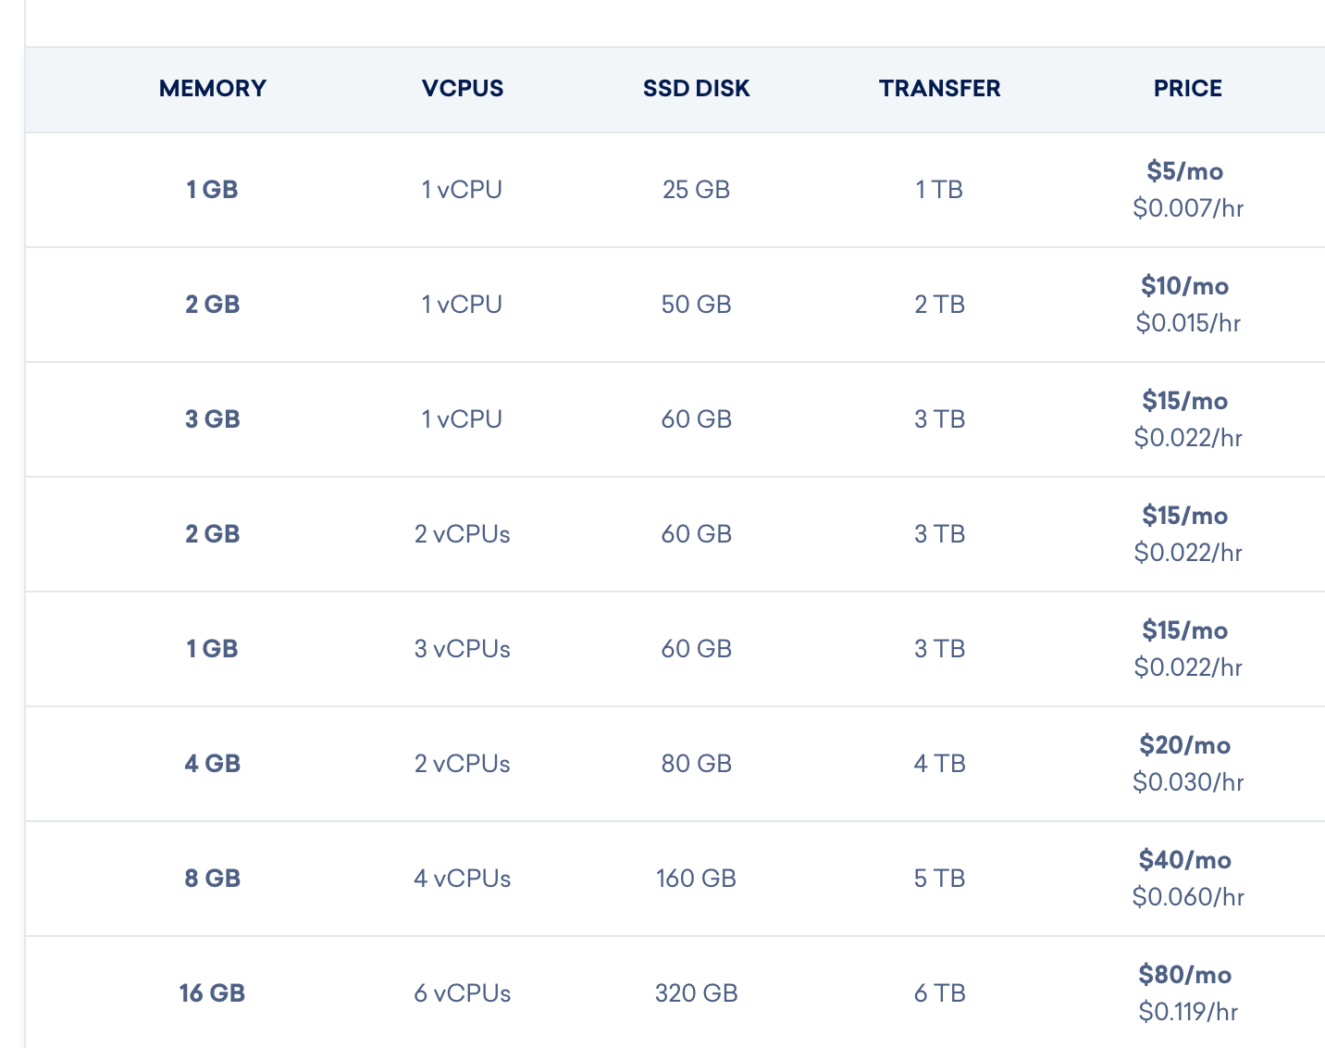
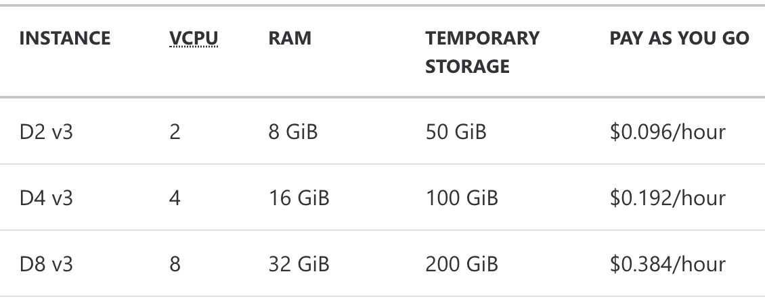


Notes:
Historical Java stack consisted of an application server running multiple applications. Red Hat has customers running over 100 applications on one JBoss EAP instance. Over most of the last 15-20 years, the Java application stack has been optimized to run large heaps and highly dynamic frameworks that make decisions at runtime.

Slide 12


The Java impedance mismatch
Java design center
Throughput at the expense of footprint
Long running at expense of startup speed
Rich, dynamic behaviour for mutable systems
Cloud-native design center
Throughput solved by scaling
Ephemeral, immutable systems
Footprint and performance matter
Notes:
But it was designed for a different era, and made tradeoffs that are showing their age in the world of cloud-native

Slide 13

Rich dynamic behavior built for mutable systems
Yet containers are primarily immutable
Notes:
[click]
In the early days of Java we saw development of frameworks which matched the design goals and target deployment platforms of Java.
These frameworks did a lot of acrobatics to keep the apps flying in the air, and even allowed developers to modify the app it as it flew.
[click]
With the rise of cloud computing and containers, this dynamic behavior and associated heavy footprint of Java apps no longer matches how developers and operations teams want to build and deploy applications today.

Slide 14
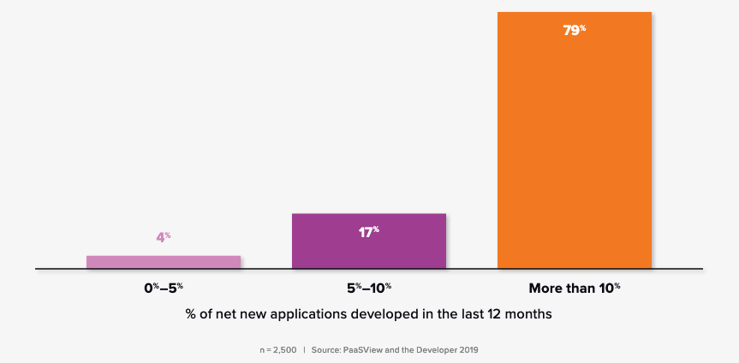
How important is containers for developers?
Figure 2: Percent of developers who use containers for net new apps.
“The popularity of Java and the emerging use of containers suggest the need to optimize the deployment of Java in container-native and Kubernetes-native environments”
IDC - Red Hat Quarkus Lab Validation
n=2,500 | Source: IDC PaasView and the Developer 2019

Slide 15
Java and containers: The hidden truth
State of Java in the Cloud
Compute node
Compute node
Compute node
HotSpot
NodeJS
Go
Go
Heap
NodeJS
Go
Go
HotSpot
Heap
NodeJS
Go
Go
NodeJS
Go
Go
HotSpot
Heap
NodeJS
Go
Go
NodeJS
Go
Go
HotSpot
Heap
NodeJS
Go
Go
Container platform

Slide 16
Languages used on AWS Lambda
State of Java in the Cloud
“Before we introduced Quarkus, many customers had started to look at alternative stacks like Go and node.js to improve performance and efficiency. These customers were weary of selecting a new language and having to hire new developers or retrain their existing Java developers.”
-- Arijit Mazumdar, WiPro Digital https://quarkus.io/blog/tag/user-story/
51%
Node.js
38%
Python
6%
Java

Slide 17

Supersonic. Subatomic. Java.
Notes:
Historical Java stack consisted of an application server running multiple applications. Red Hat has customers running over 100 applications on one JBoss EAP instance. Over most of the last 15-20 years, the Java application stack has been optimized to run large heaps and highly dynamic frameworks that make decisions at runtime.

Slide 18
DEMO Time!

Slide 19
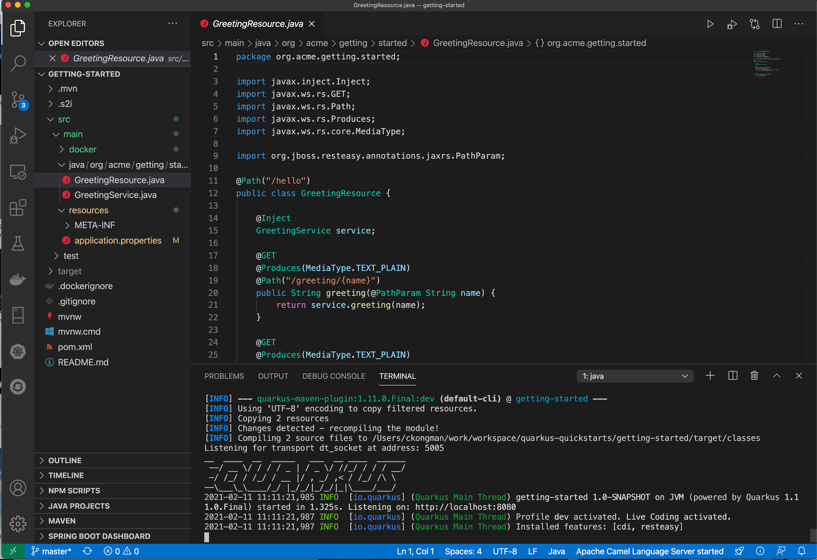
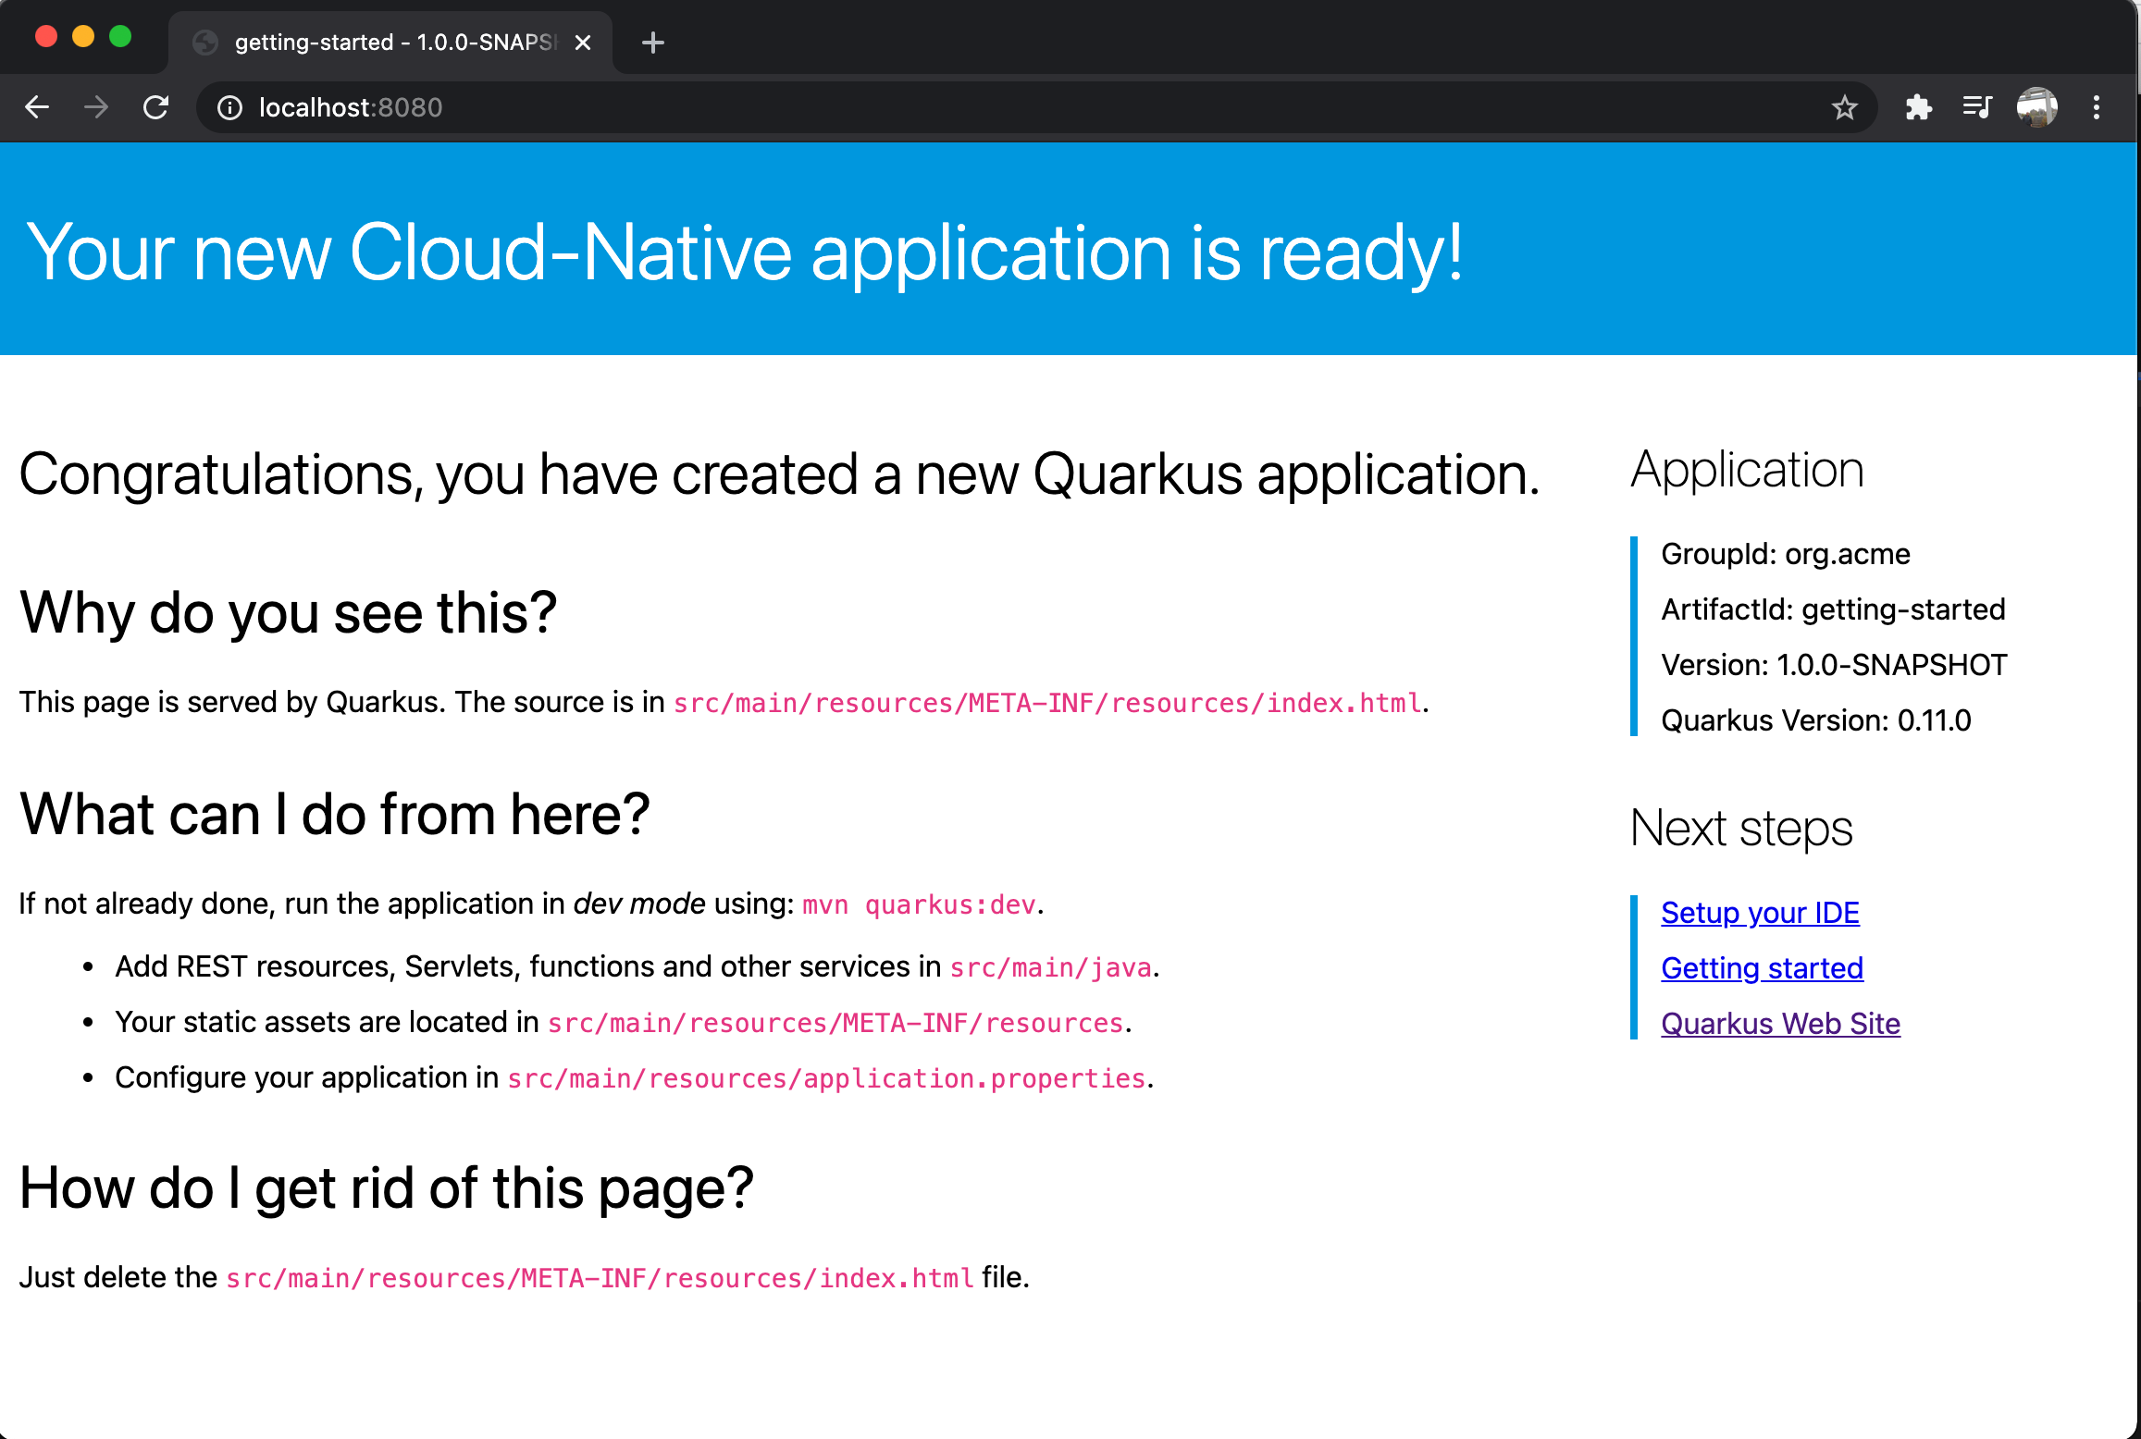
First Quarkus

Slide 20
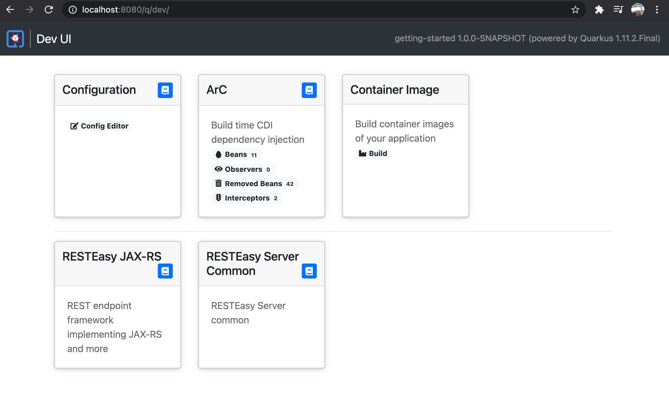
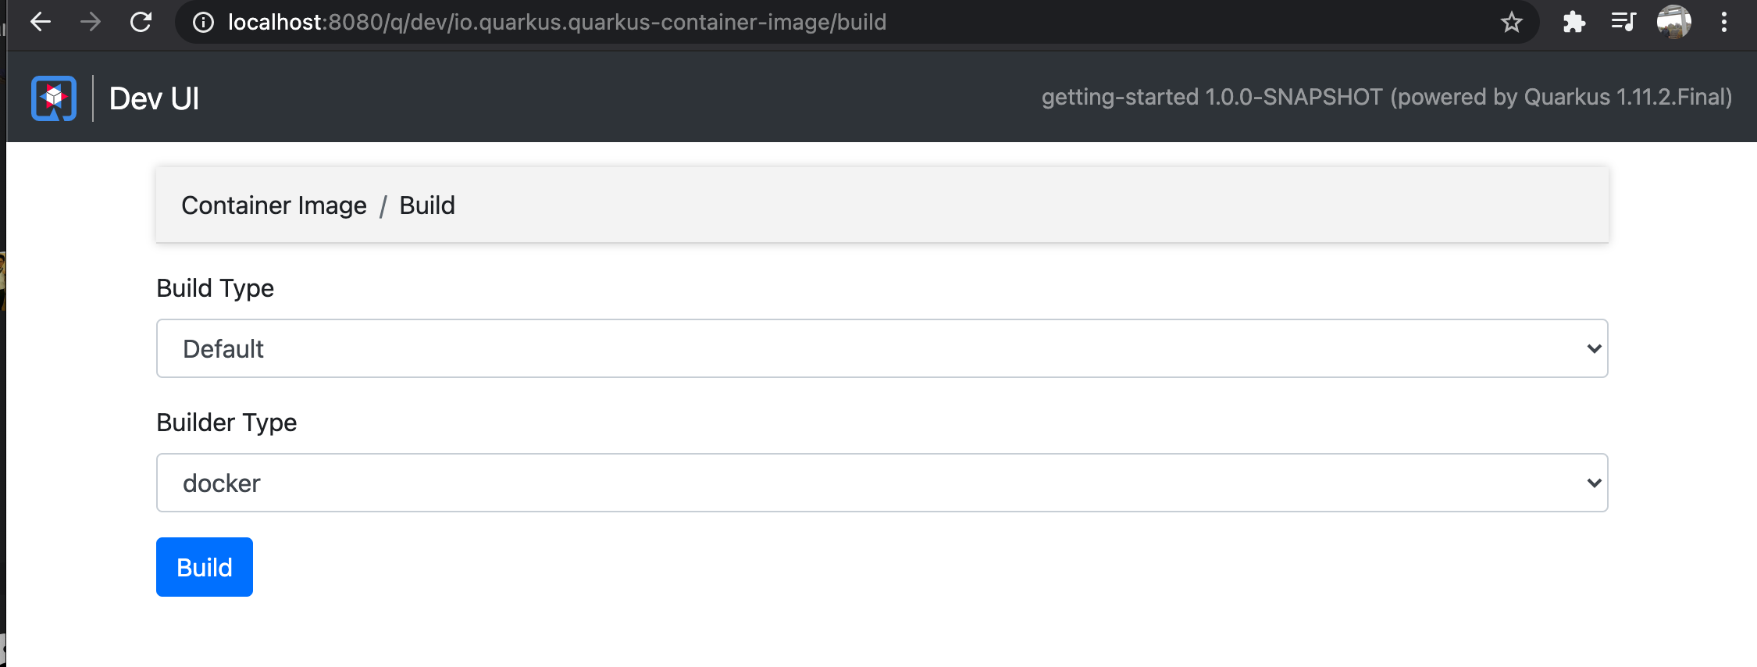
Quarkus Dev UI

Slide 21
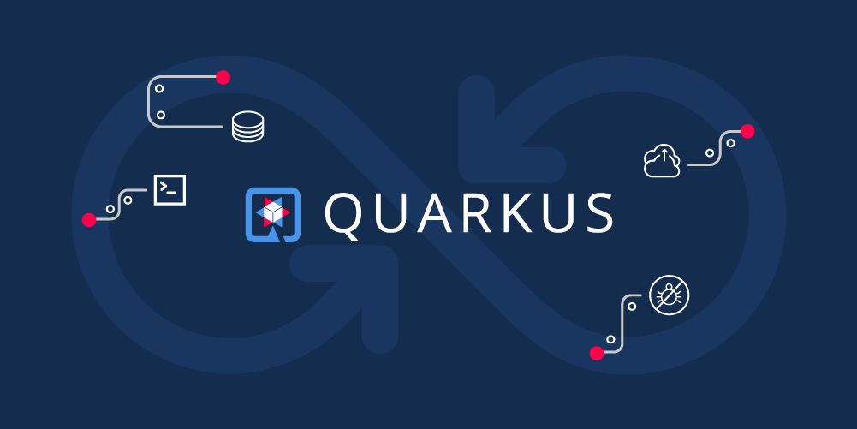
https://github.com/danieloh30/quarkus-remote
Quarkus Live Code Reload on OpenShift

Slide 22
Why Quarkus?

Slide 23
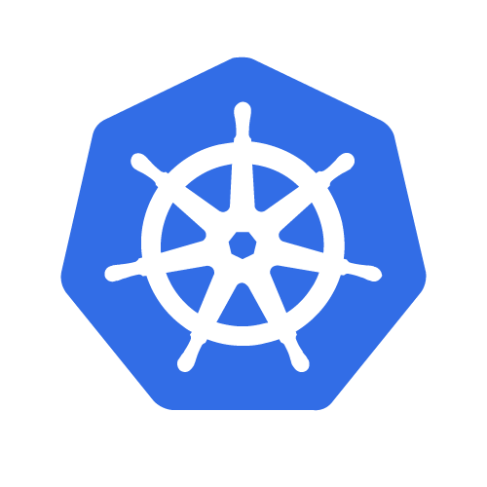

Modern Enterprise Java Stack
Architecture: Microservices Deployment: Single App App Lifecycle: Days
Memory: 100 MB + RAM
Startup Time: Seconds
App
Dynamic Application Frameworks
Application Server
Java Virtual Machine (Hotspot)
No Change
Notes:
The modern Enterprise Java stack hasn’t really changed much from the historical Java stack. Many of the same frameworks combined with some new ones, but still highly dynamic in nature. Overall not a lot of change. However, what has changed is the deployment environment, which is now Kubernetes. Kubernetes is all about immutable deployment infrastructure.

Slide 24



An Open Source
stack to write Java apps
Cloud Native
Microservices
Serverless
Notes:
Historical Java stack consisted of an application server running multiple applications. Red Hat has customers running over 100 applications on one JBoss EAP instance. Over most of the last 15-20 years, the Java application stack has been optimized to run large heaps and highly dynamic frameworks that make decisions at runtime.

Slide 25
Quarkus - Optimizing the Stack
QUARKUS WORKSHOP
Architecture: Microservices, Serverless Deployment: Single App App Lifecycle: Minutes/Days
Memory: 10 MBs + RAM
Startup Time: Milliseconds
App (Imperative / Reactive)
Optimized Application Frameworks
Java Virtual Machine (Hotspot)
Optional
Notes:
The main difference between the Traditional cloud native stack and Quarkus is that Quarkus is optimized for running in containers moving a lot of the dynamic behaviour from runtime to build time.
This provides a stack that is largely familiar for a Java developer, but starts in milliseconds and highly optimized memory usage.

Slide 26

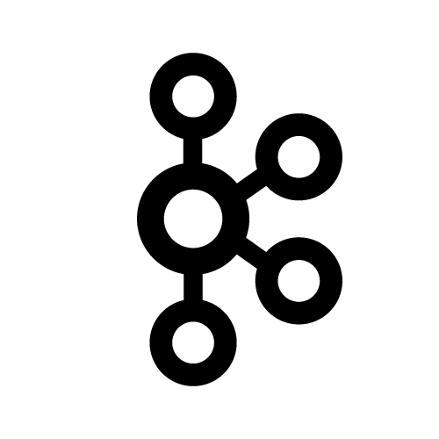

















QUARKUS WORKSHOP
Kubernetes-Native Development with Quarkus
TIOBE : #1
IEEE : #1
SlashData : #2
RedMonk : #2
Solid Foundation
Stunning Performance
Toolchain
Community
Java consistently ranks in the Top 3 of programming languages in use today with a community of 7-10 million developers.
Optimized to provide native-level memory footprint and startup time, allowing for increased density, performance and elasticity at lower cost.
End-to-end toolchain including OpenShift Developer Console, Code Ready Workspaces, project generators in IDE and web, live-reload for lightning fast inner loop workflow, and CI/CD integration.
Massive catalog of extensions connects your applications with best of breed-technologies including Camel, Jaeger, Prometheus, Istio, Kafka and more.
Notes:
Historical Java stack consisted of an application server running multiple applications. Red Hat has customers running over 100 applications on one JBoss EAP instance. Over most of the last 15-20 years, the Java application stack has been optimized to run large heaps and highly dynamic frameworks that make decisions at runtime.

Slide 27
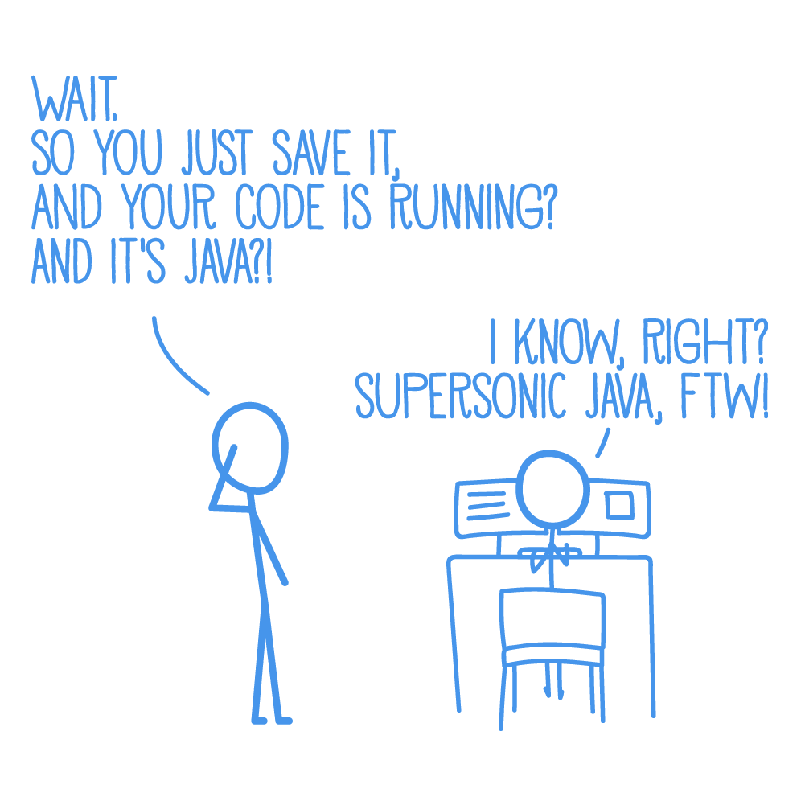
QUARKUS WORKSHOP
Quarkus brings real Developer Joy
A cohesive platform for optimized developer joy:
Based on standards, but not limited
Unified configuration
Reactive & Imperative, all in one
Zero config, live reload in the blink of an eye
Streamlined code for the 80% common usages, flexible for the 20%
No hassle native executable generation
Notes:
Historical Java stack consisted of an application server running multiple applications. Red Hat has customers running over 100 applications on one JBoss EAP instance. Over most of the last 15-20 years, the Java application stack has been optimized to run large heaps and highly dynamic frameworks that make decisions at runtime.

Slide 28
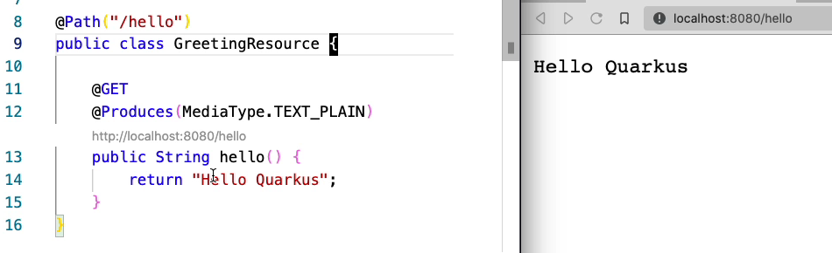
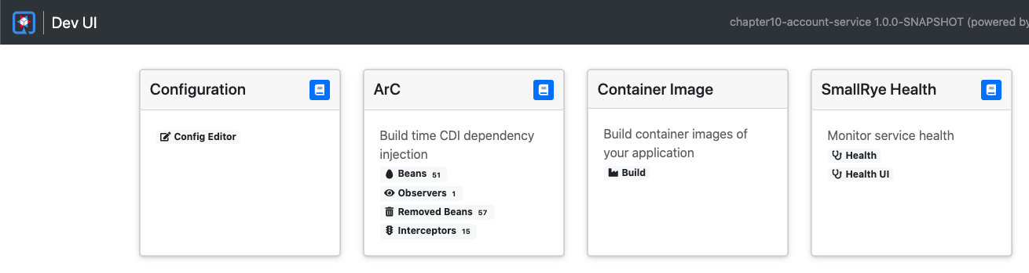
Developer Joy
Live Coding
Developer UI
Quarkus Fundamentals

Slide 29
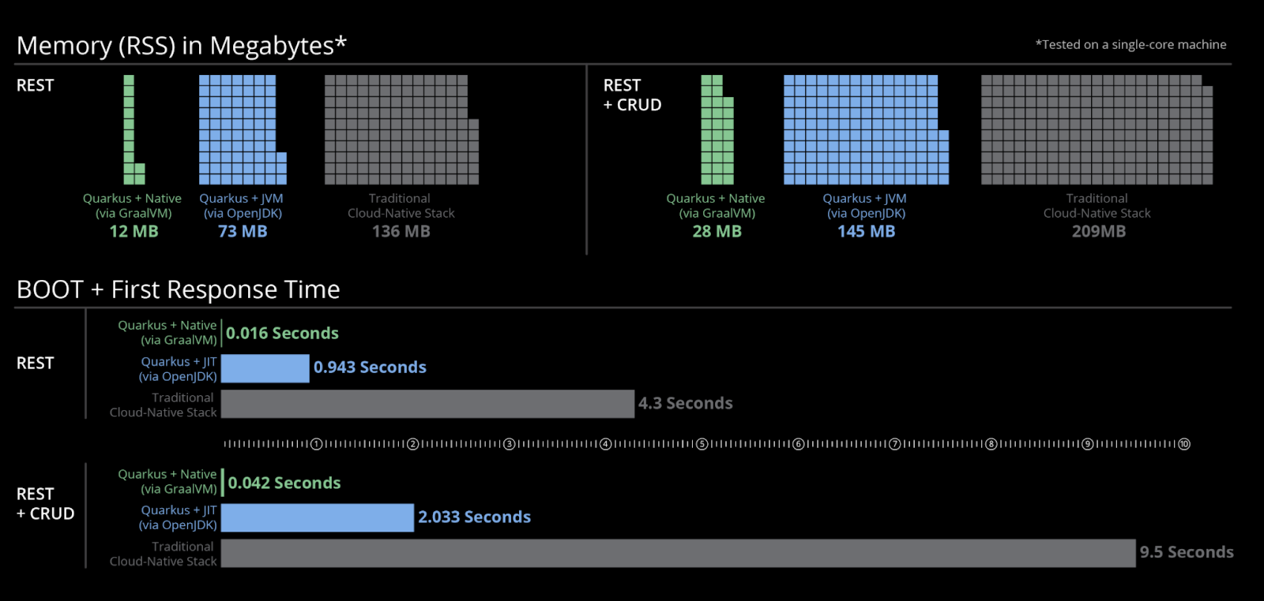
Container Native
Quarkus Fundamentals
Fast Startup and Low Memory Utilization

Slide 30
Cloud Native Java Stack + Containers
Node
Node
Node
Node
Node
EAP, WAS Liberty or Spring Boot
Quarkus on JVM
NodeJS
Quarkus Native
Quarkus Native
Quarkus Native
Go
Go
Go
Quarkus on JVM
NodeJS
Quarkus Native
Quarkus Native
Quarkus Native
Go
Go
Go
EAP, WAS Liberty or Spring Boot
Quarkus on JVM
NodeJS
Quarkus Native
Quarkus Native
Quarkus Native
Go
Go
Go
Quarkus on JVM
NodeJS
Quarkus Native
Quarkus Native
Quarkus Native
Go
Go
Go
EAP, WAS Liberty or Spring Boot
Quarkus on JVM
NodeJS
Quarkus Native
Quarkus Native
Quarkus Native
Go
Go
Go
EAP, WAS Liberty or Spring Boot
Quarkus on JVM
NodeJS
Quarkus Native
Quarkus Native
Quarkus Native
Go
Go
Go
Quarkus on JVM
NodeJS
Quarkus Native
Quarkus Native
Quarkus Native
Go
Go
Go
CONTAINER ORCHESTRATION
“We could run 3 times denser deployments without sacrificing availability and response times of services”
https://developers.redhat.com/blog/2017/03/14/java-inside-docker/
Notes:
New state of Java apps w/ Quarkus
But, memory is cheap. Do I really need another application stack?
Saving a couple of 100MB of memory and starting faster might be seen as unimportant if we consider this for a single application (a monolith). I’ve talked to several customers that where considering moving away from Java before we presented Quarkus to them. Not because they don’t like Java, but simply because when using it in on a container orchestration platform memory quickly becomes a bottleneck. The same customers have told me that they see 90% memory usage with less than 30 % CPU utilization when using Spring Boot in OpenShift. This picture illustrates the problem. If we had three different nodes in a OpenShift cluster and pinned a Spring Boot application to a single node, then did them same for a similar applications written in NodeJS and Go we can see that the number of instances that we can run are wastely lower compared to NodeJS.

Slide 31
QUARKUS WORKSHOP
Quarkus Unifies Imperative and Reactive
@Inject
SayService say;
@GET
@Produces(MediaType.TEXT_PLAIN)
public String hello() {
return say.hello();
}
@Inject @Stream(”kafka”)
Publisher<String> reactiveSay;
@GET
@Produces(MediaType.SERVER_SENT_EVENTS)
public Publisher<String> stream() {
return reactiveSay;
}
Combines both Reactive and imperative development in the same application
Reactive Messaging - Apache Kafka, MQTT, AMQP…
Reactive Services
Notes:
Historical Java stack consisted of an application server running multiple applications. Red Hat has customers running over 100 applications on one JBoss EAP instance. Over most of the last 15-20 years, the Java application stack has been optimized to run large heaps and highly dynamic frameworks that make decisions at runtime.

Slide 32
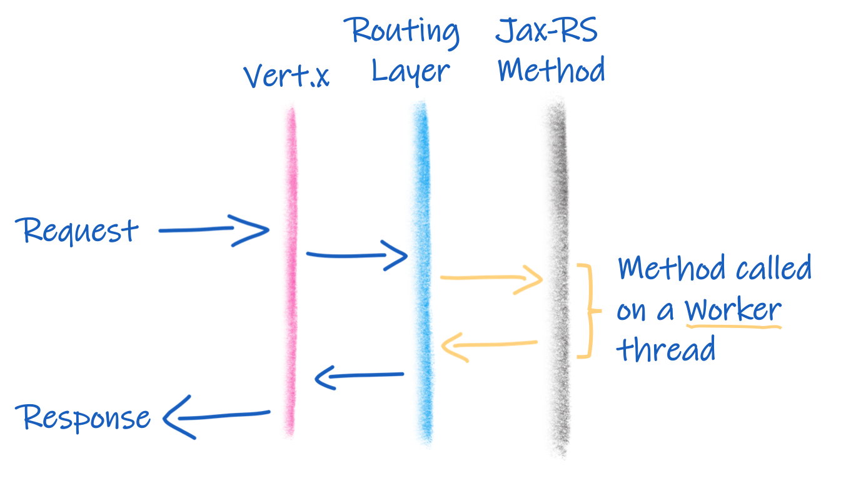
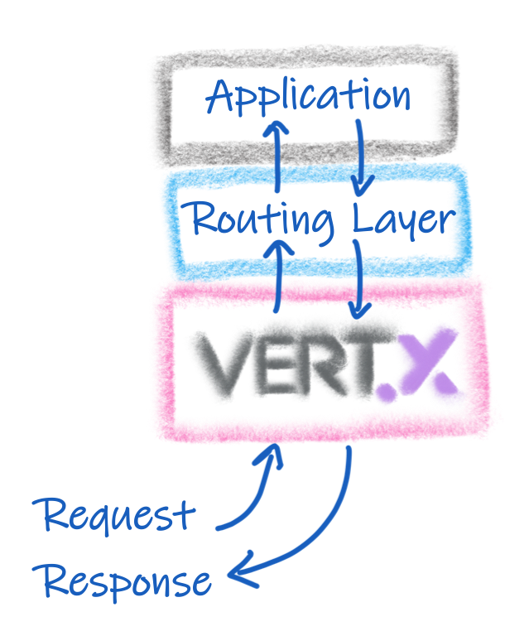
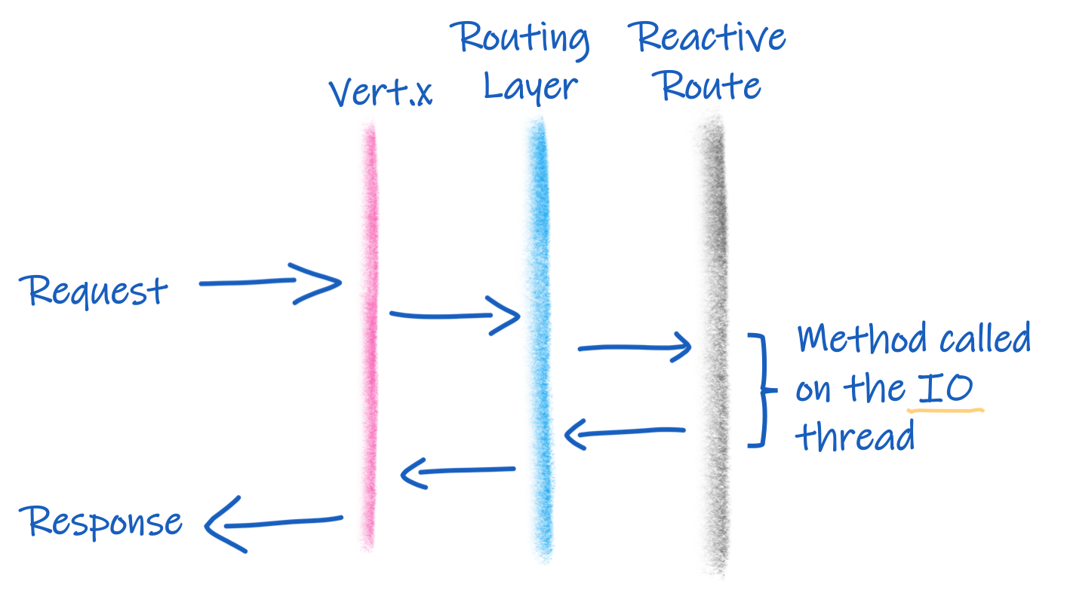
Quarkus is Reactive!

Slide 33
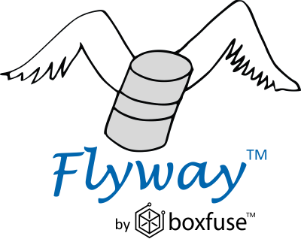





Quarkus uses Best of Breed Frameworks & Standards
Eclipse Vert.x
Hibernate
RESTEasy
Apache Camel
Eclipse MicroProfile
Netty
Kubernetes
OpenShift
Jaeger
Prometheus
Apache Kafka
Infinispan
Flyway
Neo4j
MongoDB
MQTT
KeyCloak
Apache Tika

Slide 34
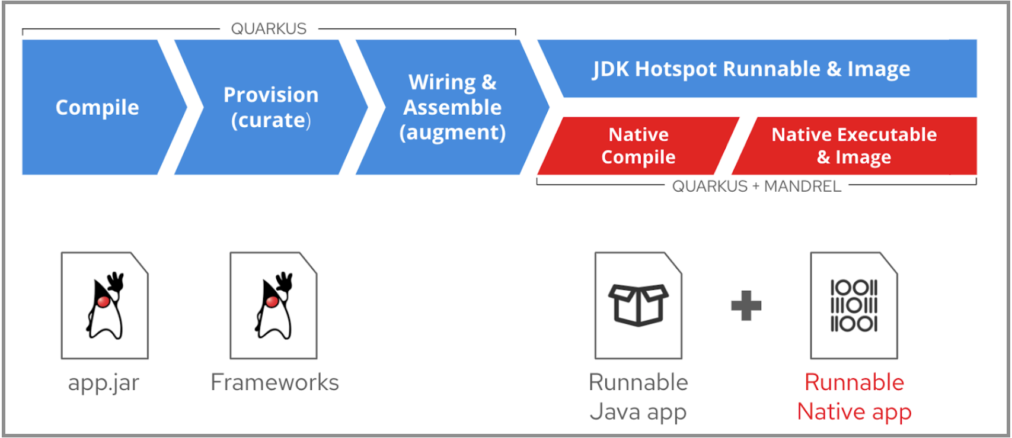
QUARKUS WORKSHOP
Build Process
Notes:
Historical Java stack consisted of an application server running multiple applications. Red Hat has customers running over 100 applications on one JBoss EAP instance. Over most of the last 15-20 years, the Java application stack has been optimized to run large heaps and highly dynamic frameworks that make decisions at runtime.

Slide 35

The Right VM For the Right Deployment
JIT (OpenJDK HotSpot)
AOT (GraalVM native image)
High memory density requirements
High request/s/MB
Fast startup time
Best raw performance (CPU)
Best garbage collectors
Higher heap size usage
Known monitoring tools
Compile Once, Run anywhere
Libraries that only works in standard JDK
Highest memory density requirements
Highest request/s/MB
for low heap size usages
Faster startup time
10s of ms for Serverless

Slide 36


Quarkus Tools - Build
mvn io.quarkus:quarkus-maven-plugin:1.3.2.Final-redhat-00001:create \
-DprojectGroupId=org.acme \
-DprojectArtifactId=getting-started \
-DplatformGroupId=com.redhat.quarkus \
-DplatformVersion=1.3.2.Final-redhat-00001 \
-DclassName="org.acme.quickstart.GreetingResource" \
-Dpath="/hello"
cd getting-started
Notes:
Developer Tools
The easiest way to scaffold a Maven project, is currently to use the Quarkus Maven plugin:
mvn io.quarkus:quarkus-maven-plugin:1.3.2.Final-redhat-00001:create \
-DprojectGroupId=org.acme \
-DprojectArtifactId=getting-started \
-DplatformGroupId=com.redhat.quarkus \
-DplatformVersion=1.3.2.Final-redhat-00001 \
-DclassName="org.acme.quickstart.GreetingResource" \
-Dpath="/hello"
cd getting-started

Slide 37


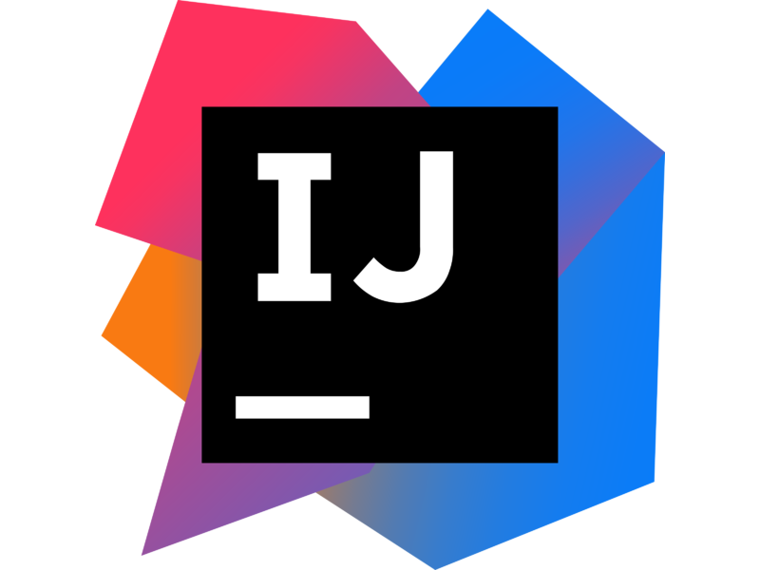

Quarkus Tools - IDE
VSCode
Eclipse
IntelliJ
che.openshift.io
Notes:
Developer Tools
Tooling done by Quarkus community and Red Hat Developer team
Language Server Based

Slide 38
Innovative Quarkus Frameworks
Quarkus Fundamentals
Standardization first requires innovation
Hibernate ORM with Panache Ease-of-use layer on Hibernate and JPA
Funqy Java API to write Functions deployable to various FaaS environments
Mutiny Express and compose asynchronous actions
RESTeasy Reactive Asynchronous JAX-RS APIs
Qute Server-side template engine

Slide 39
Kubernetes Native
Quarkus Fundamentals
Quarkus Top-10 Kubernetes Features
One-step Kubernetes deployment
Remote live-coding in Kubernetes
Direct ConfigMap and Secrets access
Health endpoints
Kubernetes Client API
OpenMetrics support
OpenTracing support
One-step KNative deployment
Functions-as-a-Service with Funqy
Fast startup and low-memory usage

Slide 40



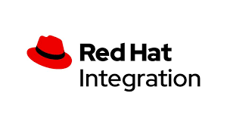

Red Hat Products Planning to Use Quarkus
Quarkus Fundamentals
Single Sign-On

Slide 41




Quarkus Included in Kubernetes & Red Hat OpenShift
Single Step Deployment
Platform Integration
IDE Integration
Support Lifecycle
Includes OpenShift developer extensions
Simplified deployment of JVM and Native mode applications
Includes support for ConfigMap/Secrets volume mounts
No-code health probes
Config via ConfigMap
OpenMetrics / OpenTracing support
Knative serving / eventing* / functions**
Remote dev/debug with Live Coding
OpenShift Dev Console**
CodeReady Workspaces plugin
Scaffold new projects
Code completion
Live Coding
Quarkus-specific API suggestions & snippets
Identical support scope vs. Runtimes
Support for 3.11, latest 4.x
Fully supported during OpenShift EUS lifecycle
OCP, OSD, ARO, etc
* Dev Preview
** Coming Soon

Slide 42

Use Cases
“Quarkus is an ideal runtime for”
NET NEW
MONO 2 MICRO
Low memory footprint + lightning fast startup time + small disk footprint = an ideal runtime for Kubernetes-native microservices
Quarkus is a great choice to modernize existing monolithic applications by breaking it into smaller, loosely coupled microservices.
SERVERLESS
EVENT-DRIVEN/REACTIVE
Scaling up or down (0) is extremely fast with Quarkus making it an ideal runtime for creating serverless applications.
Quarkus utilizes an asynchronous, reactive event loop that makes it easy to create reactive applications.
Notes:
Quarkus is a great fit for...
Net-new Microservices
Quarkus provides an effective framework for a containerized microservice architecture. It unifies imperative and reactive programming paradigms and offers an extensible set of standards-based Java libraries and frameworks to revolutionize Java development.
Mono-2-Micro
Quarkus is also a great tool to modernize existing monolithic applications by breaking it into smaller, loosely coupled microservices. This includes applications running on a traditional application server or a Spring Boot application with a large memory footprint and long boot up times.
Serverless
Due to its fast startup times, Quarkus makes Java an ideal runtime for Function as a Service (FaaS) invocations. It also has an extensive library of functionality to implement any type of business logic in a serverless environment.
Reactive/Event-Driven
Quarkus is also a great runtime for reactive systems and reactive programming. It utilizes a single non-blocking, reactive event loop for both imperative and reactive code so developers can choose the right option for their use case.
IoT/Edge
Due to its optimal server resource consumption, Quarkus is also ideal to run microservices and applications at the edge and on IoT devices allowing organizations to take advantage of underutilized edge resources and shift business logic closer to the data emitter. Running complex rules and event processing to the edge is possible with Quarkus.

Slide 43
I’m a Spring developer. Why Quarkus?

Slide 44

https://developers.redhat.com/blog/2021/02/09/spring-boot-on-quarkus-magic-or-madness/
https://github.com/edeandrea/todo-spring-quarkus.git
Spring Boot on Quarkus: Magic or madness?

Slide 45
DEMO Time!

Slide 46




“We became increasingly worried about resource consumption that Spring Boot was having while being deployed on the Kubernetes cluster… It became increasingly cumbersome to find ways to circumvent the methodology we were using just to squeeze every little bit of performance out of Spring Boot”
Christos Sotiriou
DXL Backend Chapter Lead, Vodafone Greece
Notes:
https://www.youtube.com/watch?v=RYGvDtMM95I&list=PLsM3ZE5tGAVatO65JIxgskQh-OKoqM4F2&index=4
Christos So-ted-ee-oh
, one of the lead engineers on the product, said In early 2019 the team was getting more and more concerned with performance as they grew.
Much like Java itself, incremental improvements they made in their application infrastructure were not having the desired effect.
Vodafone greece evaluated several different alternatives like Node.js, Golang, and Vert.x. Vert.x was most promising, and in fact underpins Quarkus in many ways, so when they found Quarkus in februrary it was a no-brainer.

Slide 47
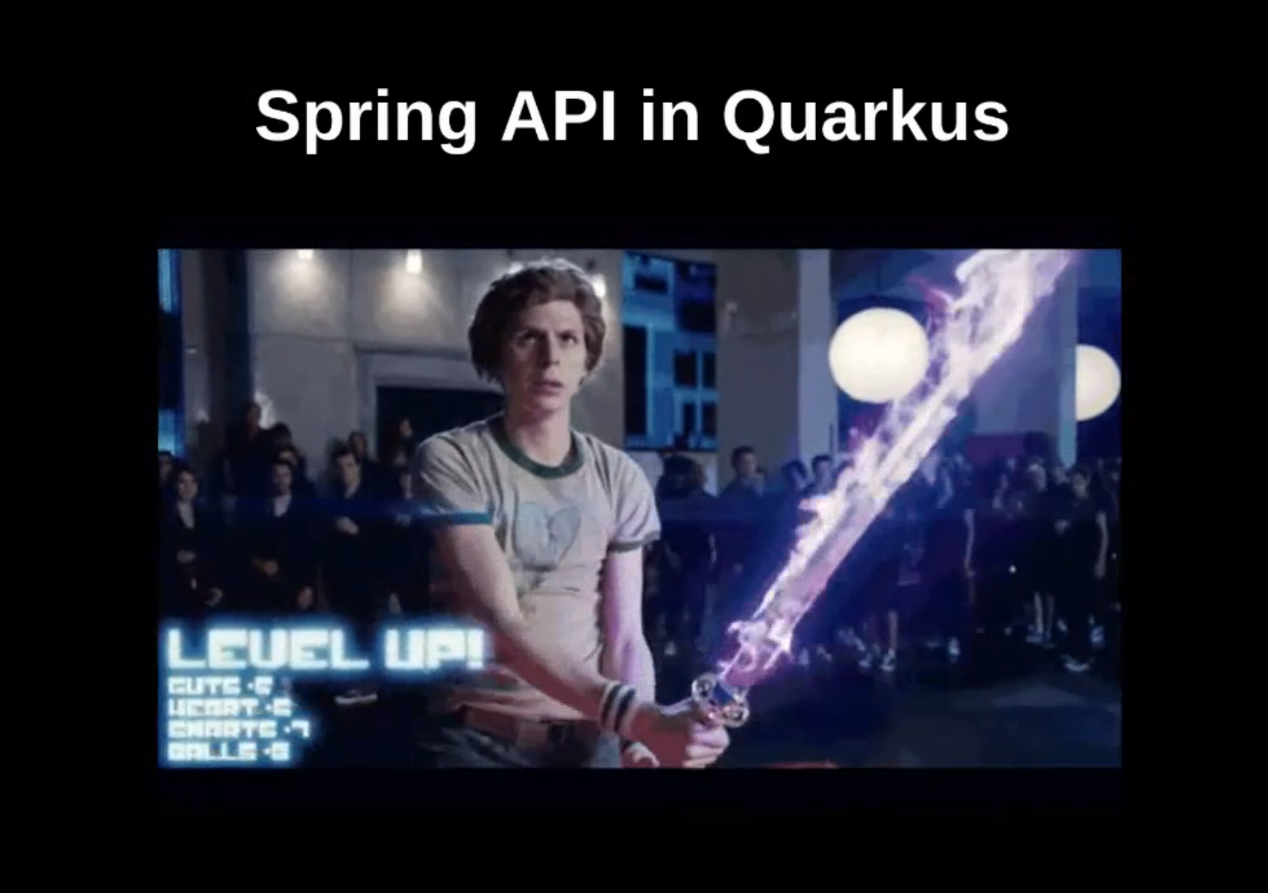
Spring in Quarkus!

Slide 48




I’m a Spring developer. Why Quarkus?
Cloud Native Application
Performance Improvement
Spring APIs to APIs
responsiveness to application lifecycle changes improves
scaling up/down
Memory Consumption & Slower startup times
Quarkus’ Spring API compatibility includes Spring DI, Spring Web, and Spring Data JPA

Slide 49


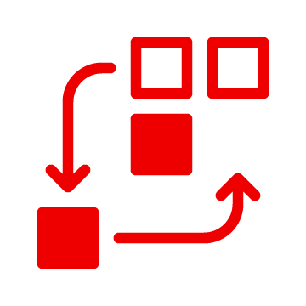

Are there additional benefits
for Spring developers?
Function-as-a-Service (FaaS) Runtime.
Live Coding.
Support for reactive and imperative models.
Early detection of dependency injection errors.

Slide 50

Spring Boot World
Spring REST
Spring DI
Spring Data JPA
Runnable java app

Slide 51
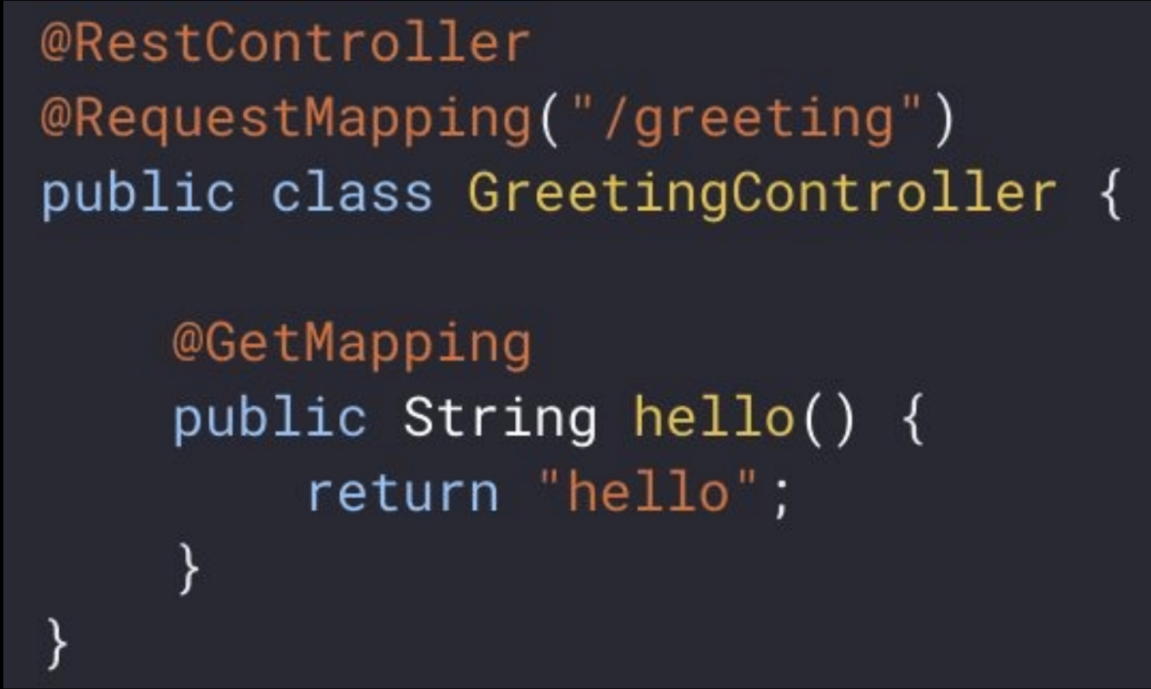
Spring Web (REST) : spring-web extension
Using same Spring API for REST
Supported Annotations
@RestController
@RequestMapping
@GetMapping
@PostMapping
@PutMapping
@DeleteMapping
@PatchMapping
@RequestParam
@RequestHeader
@MatrixVariable
@PathVariable
@CookieValue
@RequestBody
@ResponseStatus
@ExceptionHandler

Slide 52
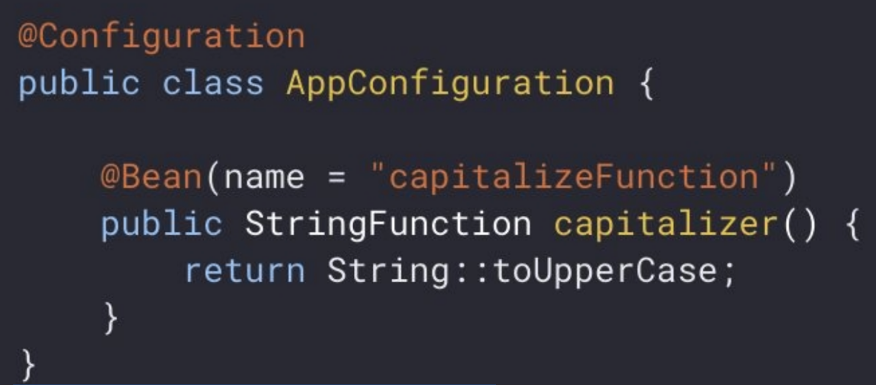
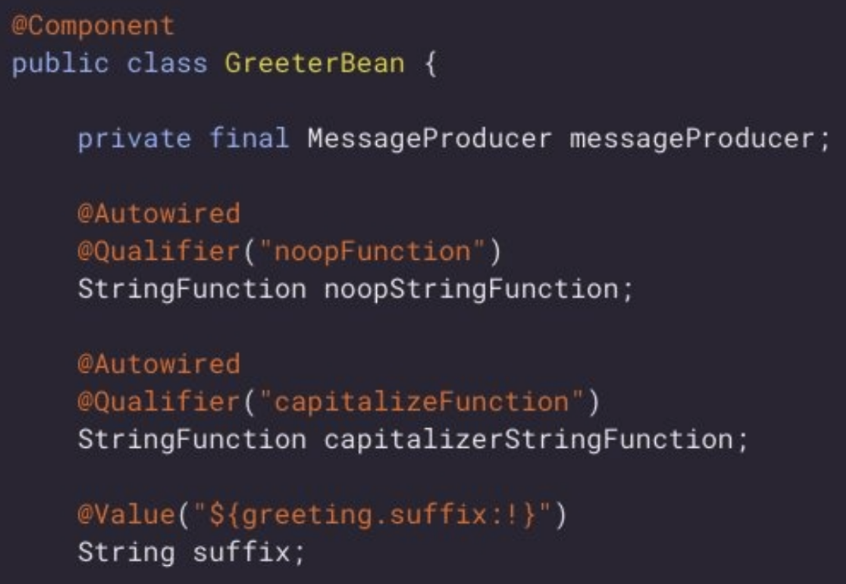
Spring DI : spring-di extension
Using same API as Spring DI
Annotations Supported
@Autowired @Repository
@Qualifier @Scope
@Component
@Configuration @Service
@Bean
@Value
* doesn’t support an expression language in @Value

Slide 53
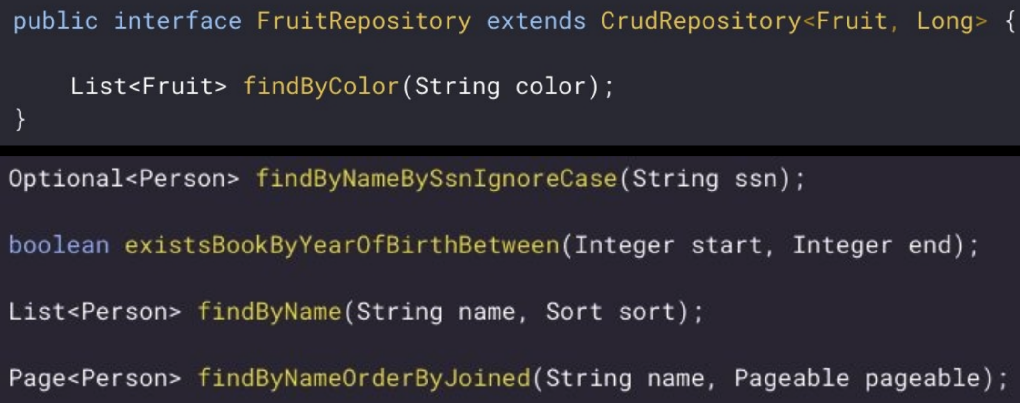
Spring Data : spring-data-jpa
Using same API for Spring Data
Supported
Any interface of : Repository,
CrudRepository, PagingAndSortingRepository,
JpaRepository
Derived Query Methods
User defined Queries
Not Supported
Invocations to any method of
QueryByExampleExecutor
QueryDSL

Slide 54
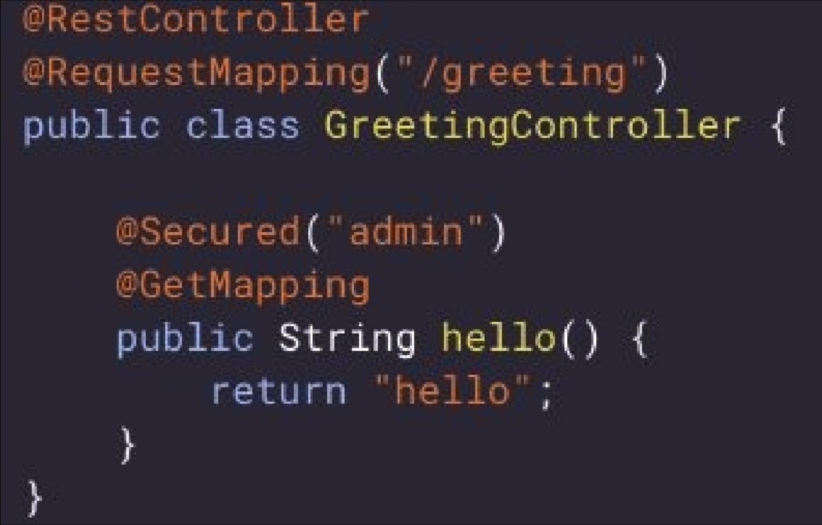
Spring Security: spring-security extension
Using same API as Spring Security
Annotations Supported
@Secured
@Preauthorized
Expressions allowed
hasAnyRole
permitAll
denyAll
isAnonymous
isAuthenticated
#paramName ==

Slide 55
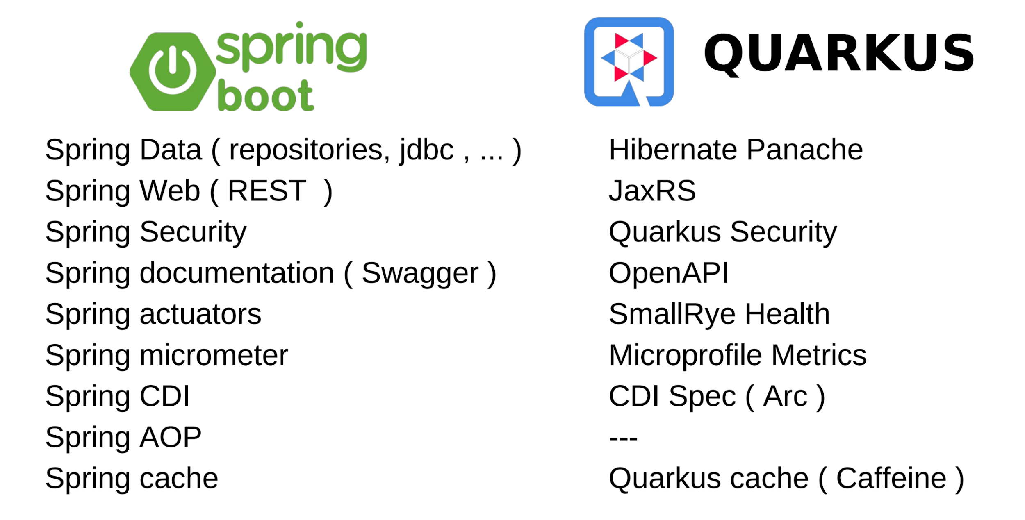
Notes:
https://quarkus.io/guides/cdi#ok-injection-looks-cool-what-other-services-are-provided
No spring aop, but have
Lifecycle Callbacks
Interceptors
Events and Observers

Slide 56
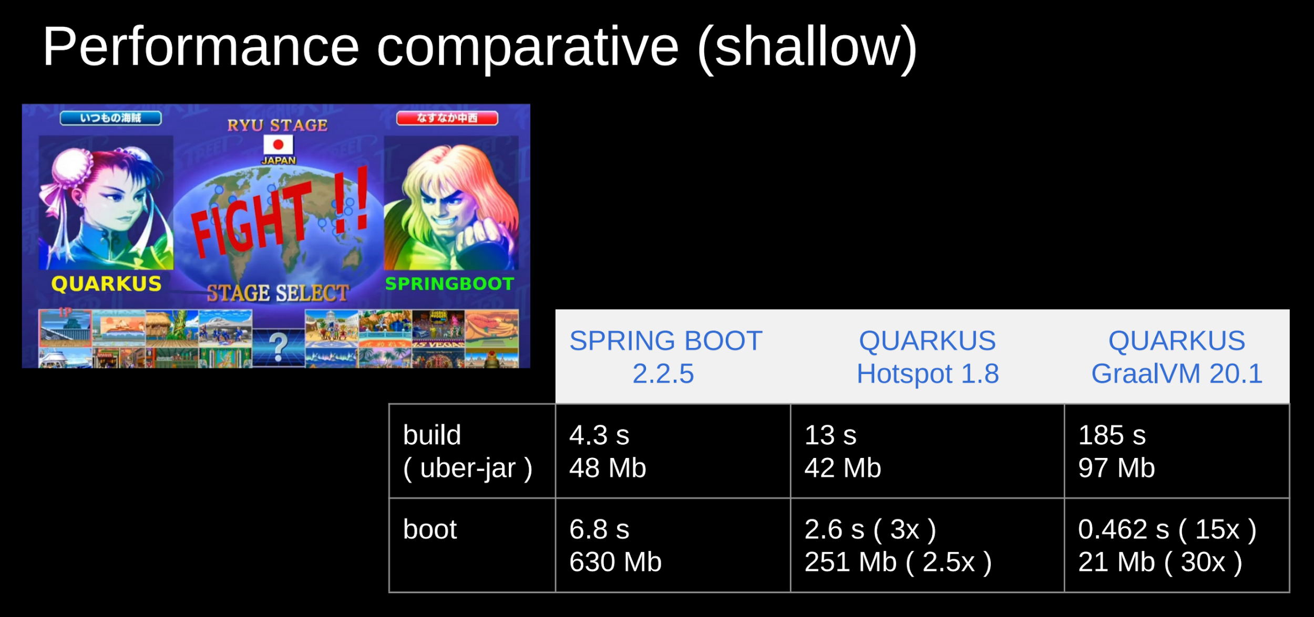

Slide 57
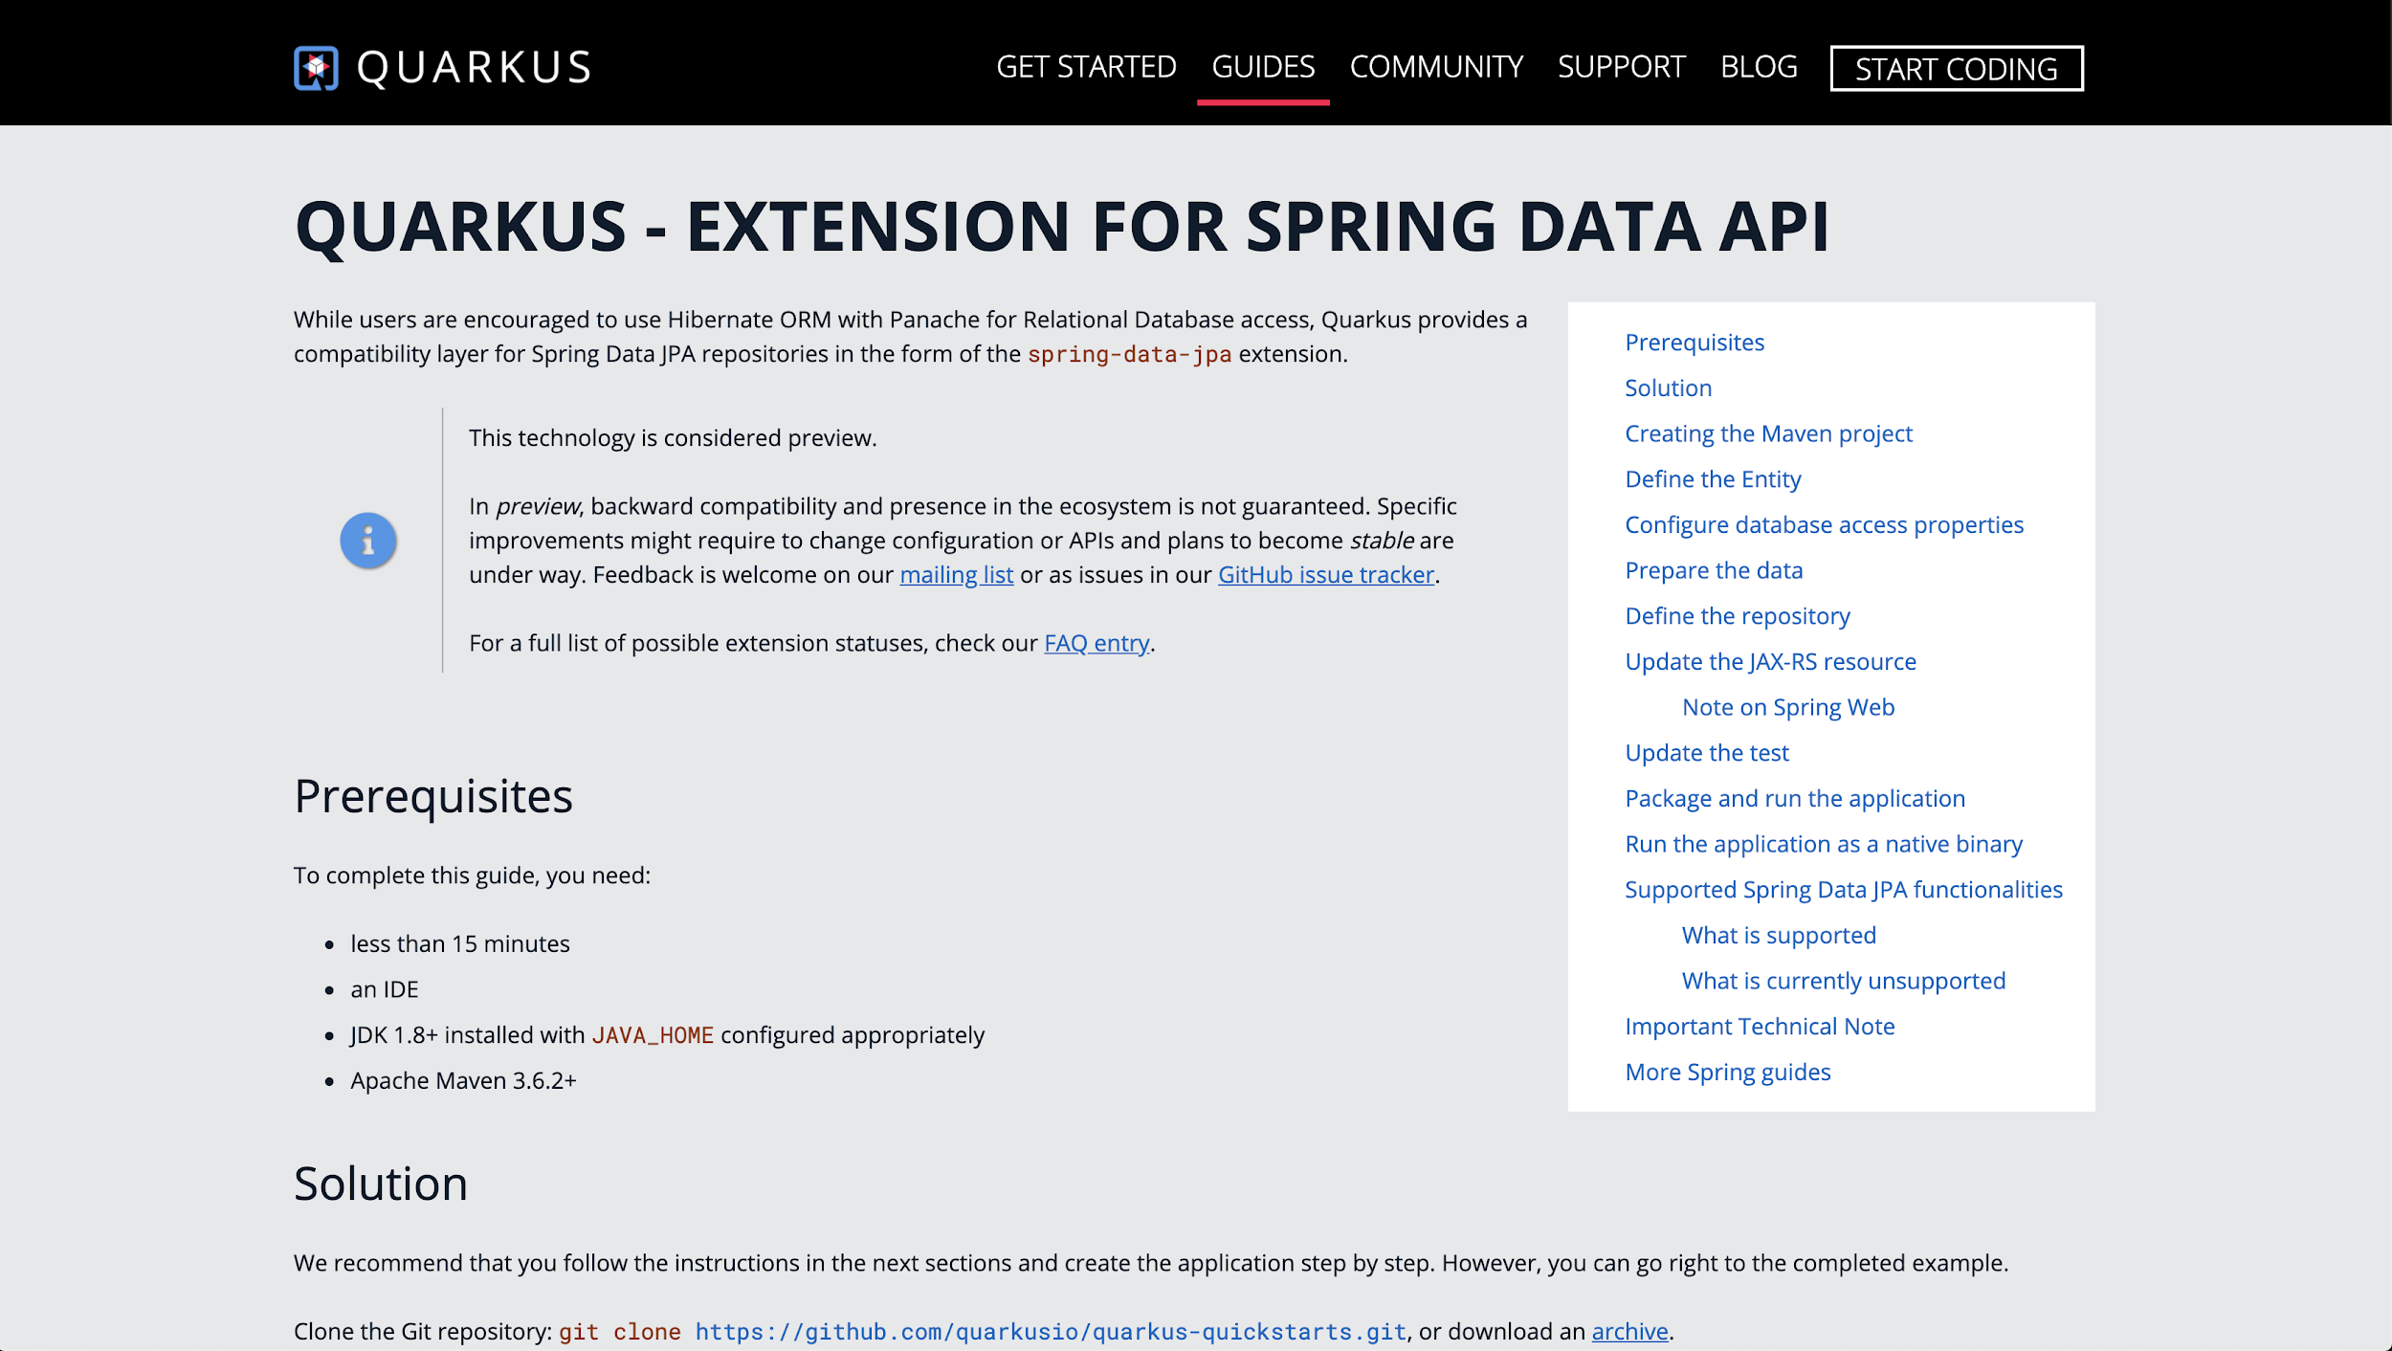
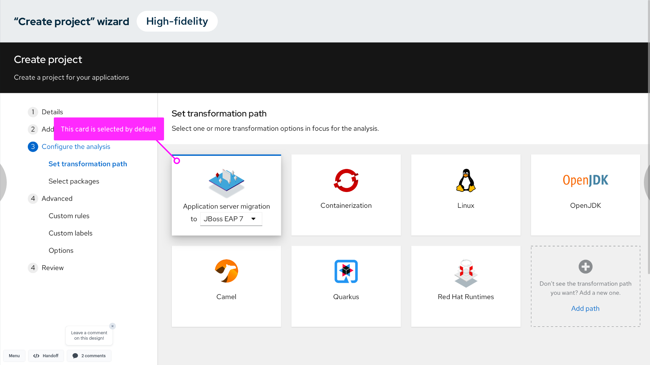
Spring to Quarkus Migration
SPRING API COMPATIBILITY IN QUARKUS
MIGRATION TOOLKIT FOR APPLICATIONS
→ A subset of Spring Framework / Spring Boot APIs in Quarkus to minimize learning curve
→ Java code analysis, effort estimation, risk identification, migration execution via Web UI, CLI, IDE Plugins.
→ New rules and UI in MTA 5.1
Notes:
Reading docs is fine, but tooling that can get you 80% of the way there is even better

Slide 58
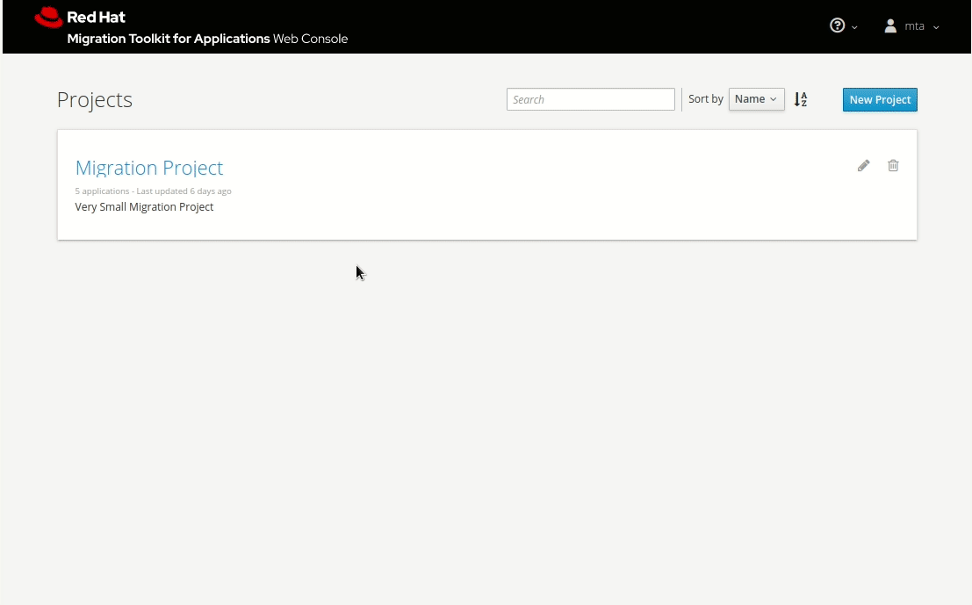
Migration Toolkit for Applications
MTA 5.1.1
Review Java Apps - review source code or decompile binaries and find ways to make them more JEE compliant, and container friendly.
OpenJDK, Container and Linux rules - discover fixes to be applied to your app to increase its mobility
Camel 2 to 3 Rules - review your Camel 2 rules and find out how to convert them to Camel 3 (more container friendly).
Web,CLI, Maven and IDE - use the tool in any your preferred context, from CI/CD pipelines , to maven builds and in within your development environment. Easy to deploy on OpenShift.
red.ht/mta
Product Manager: Miguel Pérez Colino
Notes:
Java Applications
Can be analyzed whether as source code or binaries
Rules to detect issues when migrating to JBoss EAP
Extra rules
Rules to consider issues when migrating to OpenJDK and/or Linux are also included.
12 Factor app based rules also available
New rules for Camel
147 rules in 13 rulesets added in this last version
Note: Total Number of Rules 1217 in 131 rulesets
Distributions
Web Console: runs on a laptop, standalone server or on OpenShift via templates
CLI: to be used for special cases (massive use, automated use)
Maven: it can be integrated in maven builds
IDE: runs on Eclipse, CodeReady Studio, Eclipse CHE, CodeReady Workspaces and VS Studio Code

Slide 59
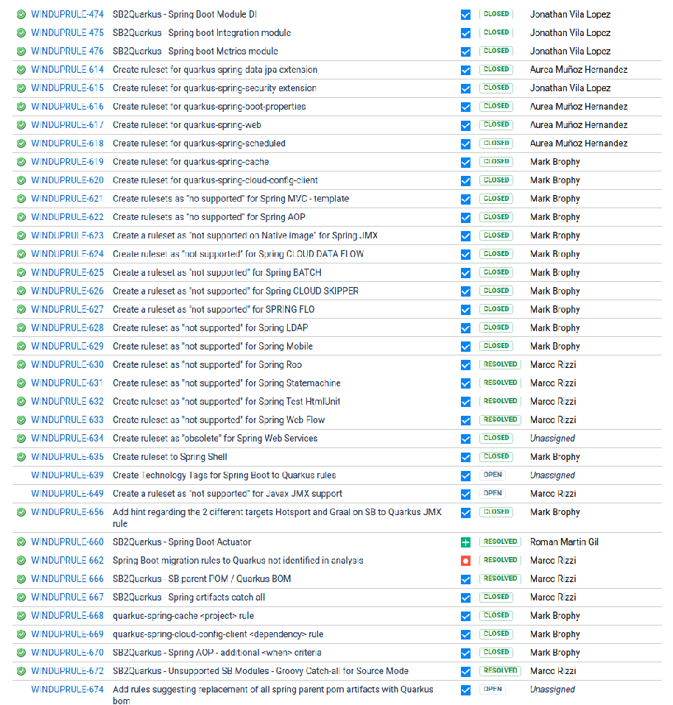
Migration Toolkit for Applications
New Rules for Spring Boot in MTA 5.1
38 new rules - covering unsupported and similar capabilities. Added new modules too to implement the rulesets properly.
Real world tested - collaboration with Red Hat Consulting to test the rules in real customer applications.
Fully integrated - Integrated in the tool with complementary rulesets like OpenJDK and/or Linux.
https://issues.redhat.com/browse/WINDUPRULE-473
Product Manager: Miguel Pérez Colino
Notes:
Java Applications
Can be analyzed whether as source code or binaries
Rules to detect issues when migrating to JBoss EAP
Extra rules
Rules to consider issues when migrating to OpenJDK and/or Linux are also included.
12 Factor app based rules also available
New rules for Camel
147 rules in 13 rulesets added in this last version
Note: Total Number of Rules 1217 in 131 rulesets
Distributions
Web Console: runs on a laptop, standalone server or on OpenShift via templates
CLI: to be used for special cases (massive use, automated use)
Maven: it can be integrated in maven builds
IDE: runs on Eclipse, CodeReady Studio, Eclipse CHE, CodeReady Workspaces and VS Studio Code

Slide 60
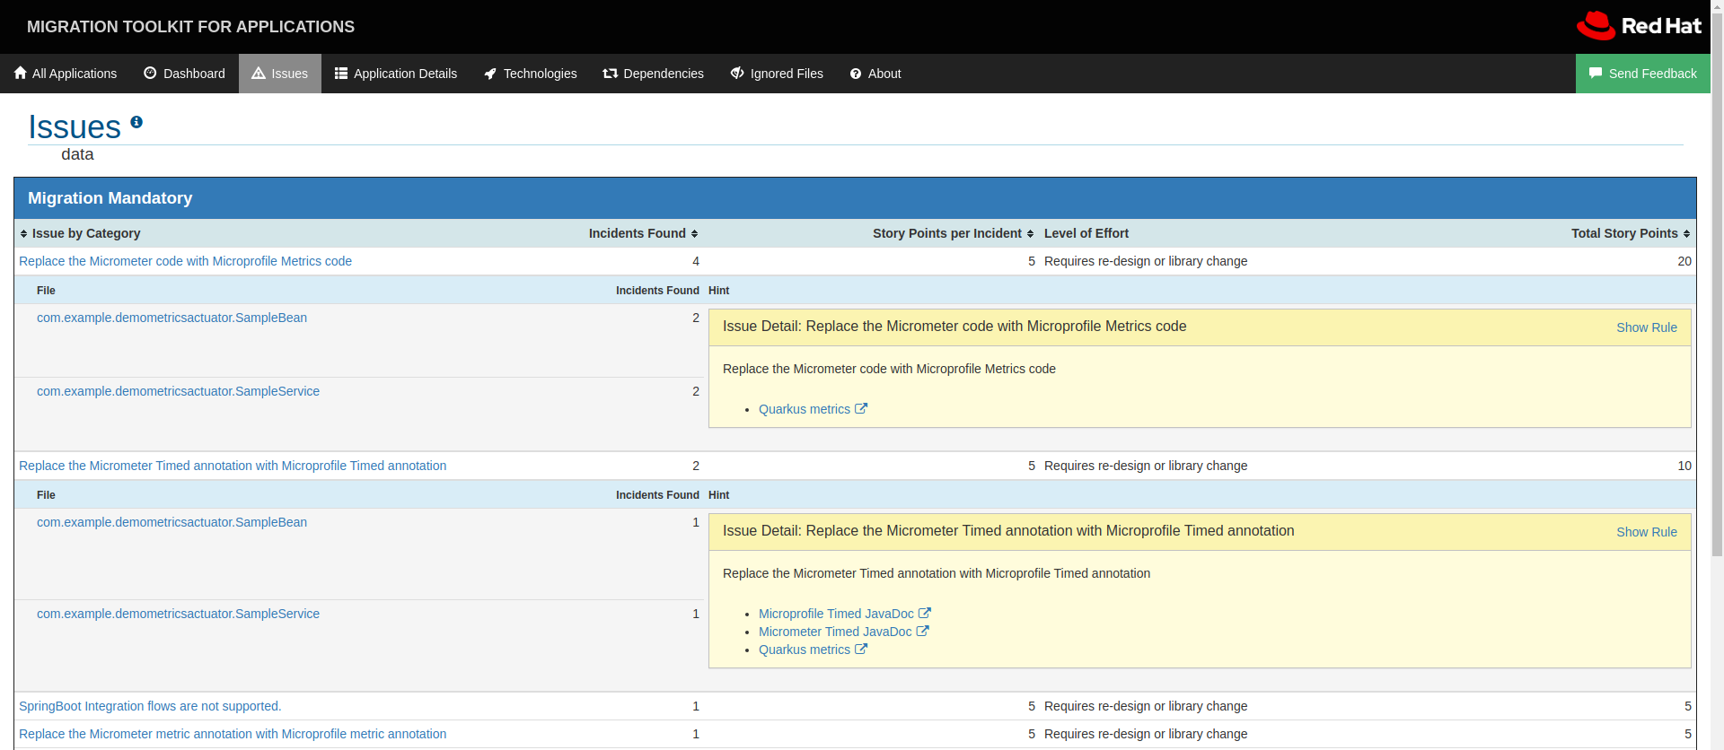
MTA 5.1 Rules
MIGRATION TOOLKIT FOR APPLICATIONS
Spring Boot to Quarkus

Slide 61

spring on quarkus live coding
Spring REST
Spring DI
Runnable java app
Spring Data JPA
native-app
https://github.com/snowdrop/spring-quarkus-demo1

Slide 62

Summary
With Quarkus
Container First
Tailors your app for HotSpot & GraalVM
Fast boot time and low RSS memory
Serverless fit
Developer Joy
Live coding
Unified configuration
Unifies Imperative & Reactive
Combines blocking and non-blocking
Built-in event bus
Best of Breed Libraries & Standards
90+ extensions
“Powered by Quarkus” applications
Notes:
Why should developers care?
Container First
Quarkus is a Kubernetes-native Java framework targeted for containers and serverless due to it’s fast startup, low memory, and small application size.
Developer Joy
Quarkus works out of the box with popular Java standards, frameworks, and libraries. Developers familiar with these will feel at home with Quarkus, which streamlines code for 80% of common use cases, while providing the flexibility to cover the remaining 20%. Quarkus also provides live coding for fast iteration during development, where code changes are automatically and immediately reflected in the running app.
Unifies Imperative and Reactive Programming Models
Developers can choose the right programming model that best fits their use case, and easily integrate their code with other components in a reactive system like reactive streams with Vert.x and Kafka, reactive database APIs, and much more.
Best of Breed Standards & Libraries
The Quarkus community has developed over 90 extensions which provide additional enhancements and integrations to the framework including the ability to compile an application into a native executable.

Slide 63
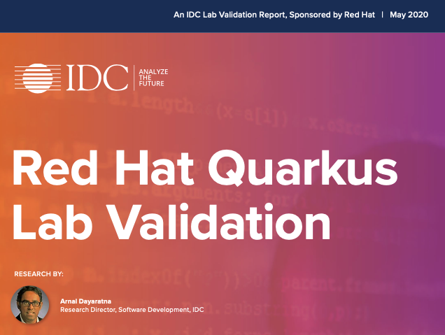
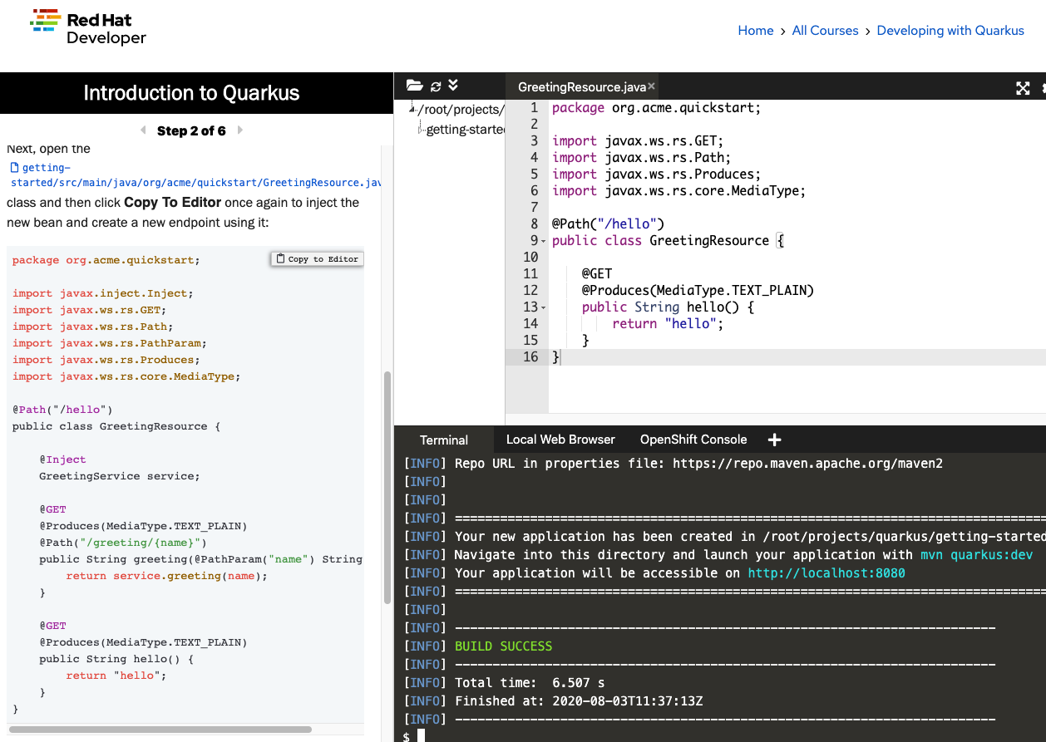






Getting Started
QUARKUS WORKSHOP
https://qrgo.page.link/3q7hr
red.ht/try-quarkus
code.quarkus.io
Assets on Quarkus
Notes:
Before you go here are a few resources to get you started. To see how quarkus compares to traditional Java for both developers and operators, check out the IDC study done a few months ago. If you want to get hands-on quickly, you can try out Quarkus directly in your browser, and if you want to dig in and build your own apps, code.quarkus.io is there for you.

Slide 64
Thank you
Red Hat is the world’s leading provider of enterprise open source software solutions. Award-winning support, training, and consulting services make
Red Hat a trusted adviser to the Fortune 500.

Slide 65
Common Questions
Notes:
Happy to add your own questions to this document!

Slide 66
Common Questions
Common questions
Quarkus Qute - Why invent a new templating technology?
Provide an opinionated & innovative templating engine
Quarkus community is a powerful innovation catalyst
Inspired by existing technologies
Asynchronous/non-blocking data resolution API
Compile-time type-safe parameter declarations
Easy integration with RESTEasy & Quarkus Mailer extensions
Is a complete rewrite the only possible migration strategy?
Intention of the path in this workshop is to show how to to a re-write & map Spring features to Quarkus
Other strategies include using MTA/Quarkus Spring compatibility extensions/etc
Quarkus Spring extensions aren’t intended to track every/all Spring features 1:1
Give “just enough” Spring to make Spring developers comfortable while trying out Quarkus
Most real life projects have specific things that might differ slightly between the Quarkus ecosystem and Spring ecosystem (i.e. fault tolerance, health checks, etc)
https://quarkus.io/blog/qute/

Slide 67
Common Questions
Common questions
I see Spring apps can be compiled using GraalVM why would I consider using the Spring Compatibility in Quarkus?
As of right now (Jan 2021) Spring has still not officially announced support for compiling to native
What has been presented so far is only a simple proof of concept project and there are still a lot of features that don't work with GraalVM
The Spring community is working on a project called Spring-native, which plans to release 0.9 in Feb 2021 and that is looking much more like a proper effort, but it will still only provide support for a small subset of the Spring ecosystem
Looking a bit further ahead Spring has not announced how they plan to offer commercial support for GraalVM and the likely answer is that VMWare will have to refer customers to Oracle and GraalVM EE for support, while we have full support for this in Quarkus already via Mandrel
I'm missing compatibility for spring-xxx
Reach out to Quarkus PM (Thomas Qvarnstrom) and provide some context as to what Spring compatibility features are missing and why it is important to the market
https://github.com/spring-projects-experimental/spring-native

Slide 68
Common Questions
Common questions
My Spring customer is using Gradle, but Quarkus does not officially support Gradle
It's correct that Quarkus does not officially support Gradle and that our documentation focuses on Maven
We do offer commercial reasonable support for Gradle in Quarkus
It's perfectly fine for a customer that is comfortable with using Gradle to keep using it for their Quarkus projects
What we document and test as part of the product package is Maven
That the official UBI Java S2I image does not support Gradle, but it's possible to build using Gradle and then use the binary build option
This is how the Quarkus tooling works out of the box anyway
We are also working on adding buildpacks that will support Gradle
Are there any case studies that discuss customer stories or cost savings?
Yes…..
https://quarkus.io/blog/tag/user-story

Slide 69
Quarkus Case Studies

Slide 70


Quarkus IDC Lab Validation
Quarkus Case Studies
https://red.ht/idc-quarkus-study
Notes:
Potential questions - what about Python/Ruby/.NET Core? Those are not part of Runtimes but are covered under a RHEL subscription
The ability to select the “right tool for the right task” gets easier when you can access to multiple frameworks including Java EE, Spring, Node, Reactive, Serverless, Jakarta EE and Microprofile - all on the same platform. Just like our customer have done by empowering Developers with a Polyglot Application Platform, Courtesy : RHOAR. Read more on slide 32
This delivers the flexibility and freedom developers want, AND provides architects and IT leaders with a set of larger components to decide the best route to standardization when necessary.
Red Hat Runtimes also provides known Java runtimes.
Mention Quarkus as well

Slide 71

Vodafone replaces Spring Boot with Quarkus
Quarkus Case Studies
50-60%
Reduction in resource demands
Challenge
Aggressive plan to move to microservices and the cloud
Had primarily Java developers, but evaluating Node.js due to lower resource costs & greater application density
Wanted to avoid delays due to retraining Java developers on Node.js
Solution: Red Hat Quarkus
Quarkus resulted in > 50% reduction in resource demands for Java microservices
Avoided costly developer retraining from Java to Node.js
Quarkus’ hot-reload made developer flow faster = 20 microservices built in weeks
https://www.informationweek.com/devops/programming-languages/why-vodafone-greece-devs-migrated-to-red-hats-quarkus/a/d-id/1337956
https://quarkus.io/blog/vodafone-greece-replaces-spring-boot
Notes:
The main criteria for their selection process to find a replacement for Spring Boot were developer efficiency, lower cloud resource consumption and shorter applications boot-up times
The Quarkus project’s high activity characteristics, such as number of community members, project stars, quick turnaround to replies and fixes by Quarkus developers to community issues, and number of Red Hat developers thoroughly answering technical questions via the project communication channels were positive indicators for them to select Quarkus.
Also, their trust of Red Hat combined with its credibility in the software market gave them the assurance that they were making the right choice

Slide 72

Quarkus Industry Validation
Quarkus Case Studies
https://www.logicmonitor.com/blog/quarkus-vs-spring
https://www.logicmonitor.com/blog/how-we-use-quarkus-with-kafka-in-our-multi-tenant-saas-architecture
Boot + First Response Time (in seconds)
Notes:
As you can see from the linked blog post, which was in no way sponsored by Red Hat, that testing the same functionality in an application between Quarkus & Spring Boot, the application used
15% of the same CPU resources
12% of the same memory footprint
and started up 85% faster

Slide 73



Efficient Java in the Cloud with Quarkus
Quarkus Case Studies
Comparison vs Spring Boot
https://horizons.carrefour.com/efficient-java-in-the-cloud-with-quarkus
Notes:
That’s where Quarkus comes in - it is built from the ground up with containers in mind (although to be perfectly clear - running in containers isn’t at all a requirement)
Quarkus is a way to build container-native applications in Java
If you think about one of the premises of containers - containers are ephemeral, meaning each instance of the same container image is the same
As I said before - there are lots of things in Java that are done when the jvm starts up because, well, thats just the nature of java & why it was invented
But in the container world, if our containers are ephemeral, then why should I have to pay that penalty each & every time I start the container if each instance is exactly the same as every other instance
Quarkus is the “secret sauce” that moves all of this stuff the jvm has to do to build time instead of runtime, so that at runtime you get a much smaller application from a CPU, Memory, & application binary size
You can even take it a step further and eliminate the jvm completely and compile your application into a native binary
Because of the compile-time benefits Quarkus gives, Quarkus enables you to build applications that are “fit-for-purpose” for these kinds of serverless or event-driven architectures
Without having to re-tool your developer’s skillsets!
JAX-RS, hibernate, etc
Get density for your apps
Don’t have to switch away from skillsets your developers already have in order to get better application density and/or performance
As you can see from this blog post, which was in no way sponsored by Red Hat, that testing the same functionality in an application between Quarkus & Spring Boot, the application used
15% of the same CPU resources
12% of the same memory footprint
and started up 85% faster

